Slide 1
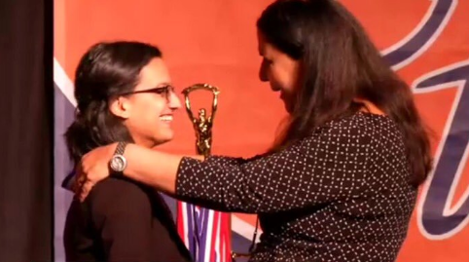
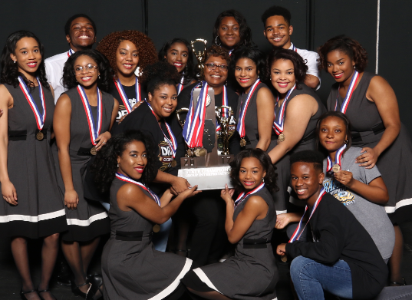
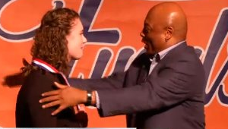
How to Make Leaders Out of Coaches
Susie Knoblauch, IHSA Assistant Executive Director
Jan Heiteen, IHSA Speech: Individual Events State Final Manager
Notes:
How to Make Leaders Out of Coaches
Susie Knoblauch, IHSA Assistant Executive Director
Jan Heiteen, IHSA Speech: Individual Events State Final Manager
What would your program be like if you were the person who came to mind every time someone said they need X, Y, and Z? Becoming the go-to person in your profession takes consistent, clear, and laser-focused effort. It is our role to make leaders out of coaches in our state so they become advocates for themselves and others. You must be bold in your beliefs and teaching, and you must be seen as a resource in your community. Sound difficult? It’s not difficult, but it takes getting a few things nailed down with crystal-clear precision and accuracy, so that people know EXACTLY what you do and who you serve.

Slide 2
What is the IHSA?
The Illinois High School Association, founded in 1900, is a not-for-profit organization of over 800 public and private high schools. The IHSA is governed by an eleven-member Board of Directors, who are principals of member schools.
Notes:
What do we do and who do we serve
Founded on December 27, 1900, the Illinois High School Association is a private, not-for-profit organization with more than 800 member high schools in Illinois. The IHSA is headquartered in Bloomington, Illinois, and is not funded by tax dollars or administered by the government in the state of Illinois.
People
The principals who make up the IHSA Board of Directors volunteer their time and energy to serve the IHSA and its member schools. Each Board member represents a geographic division in the state after being nominated and then elected in a vote by other principals in that division.
The IHSA staff administers the state tournaments in all IHSA sanctioned activities and sports, including the selection of State Series sites, assignment of officials and on-site state final management. The staff is responsible for the education and enforcement of the by-laws that its member schools vote into existence.
Effecting Change
The rules that govern the setup and scheduling of each state tournament are known as the Terms & Conditions. Every sport and activity has a geographically diverse Advisory Committee that can offer recommendations to change the Terms & Conditions. A committee of Athletic Directors provides feedback on each recommendation to give the Board of Directors feedback from several groups before they cast the deciding vote.
Any member school can propose a new by-law or a change to an existing by-law. Those proposals are reviewed by the IHSA Legislative Commission, a 35-person group of Principals and Athletic Directors from around the state. The proposed changes are then reviewed for all IHSA member schools at mandatory Town Hall Meetings held at 28 different high schools throughout the state each November. The Legislative Commissioners then vote on whether each proposal should appear on an all-school ballot based on the feedback of the member schools that attend their Town Hall Meetings. The proposals that are moved forward by the Legislative Commission are voted on by every member school and must have a simple majority to become a by-law.

Slide 3
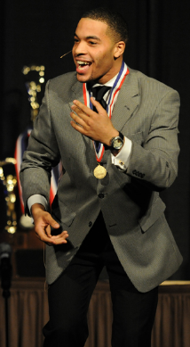
Structure of the IHSA
The IHSA governs the equitable participation in interscholastic athletics and activities that enrich the educational experience.
1 State Association
31 Sports & 9 Activities
Over 368,000 Participants
Notes:
30 Sports & Activities
Boys Athletics
The IHSA offers 14 statewide championship series for boys. The series (and the year the first state champion was crowned) are: Baseball (1940), Basketball (1908), Bowling (2003), Cross Country (1946), Football (1974), Golf (1916), Gymnastics (1952), Lacrosse (2018), Soccer (1972), Swimming & Diving (1932), Tennis (1912), Track & Field (1893), Volleyball (1992), Water Polo (2002), and Wrestling (1937).
The series are conducted during the school year as follows: Fall — Golf, Soccer, Cross Country, and Football; Winter — Swimming & Diving, Wrestling, and Basketball, and Bowling; Spring — Lacrosse, Tennis, Track and Field, Gymnastics, Volleyball, Water Polo, and Baseball.
Girls may compete on boys teams under certain circumstances. Wrestling and football are the boys sports with the most female participants.
Girls Athletics
The IHSA offers 15 statewide championship series for girls. The series (and the year the first state champion was crowned) are: Badminton (1977), Basketball (1977), Bowling (1973), Competitive Cheerleading (2006), Competitive Dance (2013), Cross Country (1979), Golf (1975), Gymnastics (1977), Lacrosse (2018), Soccer (1988), Softball (1976), Swimming & Diving (1975), Tennis (1972), Track & Field (1973), Volleyball (1975) and Water Polo (2002).
The series are conducted during the school year as follows: Fall — Golf, Tennis, Cross Country, Swimming & Diving, and Volleyball; Winter — Bowling, Competitive Cheerleading, Competitive Dance, Gymnastics, and Basketball; Spring — Lacrosse, Track & Field, Badminton, Soccer, Water Polo, and Softball.
Boys may not compete on girls teams except in Competitive Cheerleading and Competitive Dance.
Non-Athletic Activities
The IHSA offers state championships in Bass Fishing, Team Chess, Debate, Drama & Group Interpretation, Journalism, Music (in separate Solo & Ensemble and Organization Contests), Scholastic Bowl, and Speech Individual Events.
Athletic Officials
Through its Officials Department, the IHSA provides the member schools with a listing of more than 14,000 active athletic officials in Baseball, Basketball, Competitive Cheerleading, Competitive Dance, Cross Country, Football, Boys Gymnastics, Girls Gymnastics, Boys Lacrosse, Girls Lacrosse, Soccer, Softball, Swimming & Diving, Track & Field, Volleyball, Water Polo, and Wrestling. Each official who receives reimbursement for officiating a contest between member schools must be registered with the IHSA. Athletic officials are required to attend rules meetings each year to learn the rules, officiating techniques and skills necessary to provide for the proper conduct of interscholastic competition between school squads. Many also attend clinics during the year. In addition, the IHSA enrolls member officials in NFIOA.
IHSA.org
The official Web Site contains "everything you'd ever want to know about the IHSA" and then some. It contains pages for every IHSA athletic and non-athletic activity, real time scoring for most state final tournaments, the Officials Department, and many other pages. The IHSA Constitution, By-laws and Board Policies are also on the Web site.
Opened to the public in January, 1996, IHSA.org is the association's primary mode of communication with its member schools and licensed officials, as well as media, parents, students, and fans. In a typical school year IHSA.org receives more than 100 million page views from about 3 million unique visitors.
Student/School Welfare
IHSA provides catastrophic injury insurance protection for students involved in all state tournament series. Guided by the efforts of its Sports Medicine Advisory Committee and Illinois Advisory Council on Player Safety, the IHSA highlights the steps it has made in the name of student-athletes safety via its initiative and website, Play Smart. Play Hard.
Administration
A full-time staff of 23, operating from the Association's office in Bloomington, is charged with the responsibility to administer the activities according to the IHSA purpose and within the framework of the Constitution and By-laws.
Communication
The IHSA maintains a clear channel of communication between member schools and persons associated with member schools through numerous direct mailings, other publications, pamphlets, and information posted on the IHSA's Web Site.
State Final Television Coverage
The Boys Football championship games and the Boys and Girls Basketball state final tournaments are broadcast on the IHSA Television Network, a network of basic cable stations throughout Illinois which cover IHSA programming. These and most other state championships are streamed directly over the Internet on IHSA.TV.
Add A. Tude
The nation's first sportsmanship mascot first appeared at the inaugural Sportsmanship Summit on September 29, 1997. Now Add A. Tude™ appears at IHSA state final tournaments and visits member school through a regular year-long booking program. Add A. Tude™ plays a key role in sportsmanship education and promotion campaigns conducted by IHSA in conjunction with the Illinois Elementary School Association (IESA).

Slide 4
Governance of the IHSA
IHSA Board of Directors
IHSA Legislative Commission
IHSA Executive Director
IHSA Assistant Executive Directors
Advisory Committees
Member Schools
Notes:
Governance at the IHSA
IHSA Board of Directors – Set Policy, Review Appeals, Etc…
Legislative Commission - Amendment Proposals Are Collected Annually And Reviewed By The Legislative Commission.
Constitution
By-laws
Advisory Committees
Terms and Conditions For Each Specific Sport And Activity
( T&C Are The Rules Governing Each State Championship Series)

Slide 5
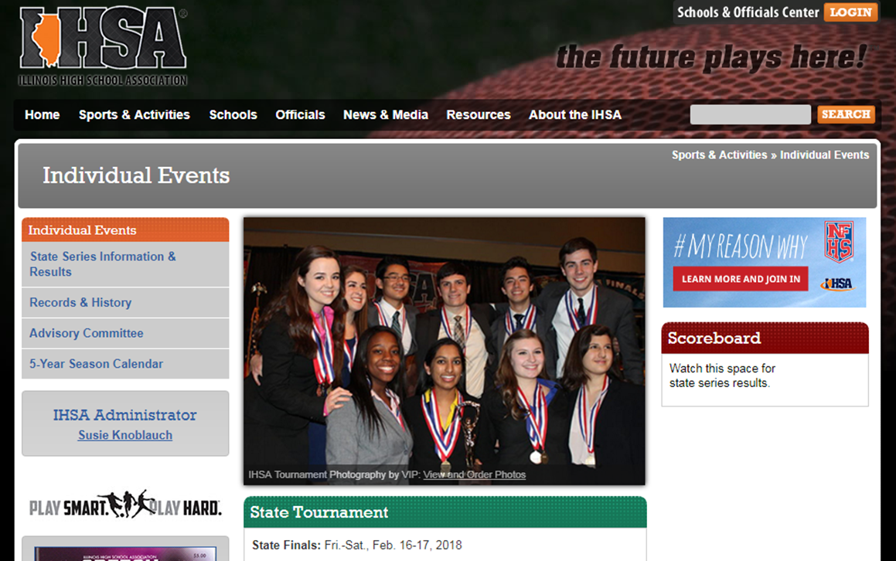
IHSA Activities
CHESS
INDIVIDUAL EVENTS
MUSIC-SOLO AND ENSEMBLE
DEBATE
DRAMA AND GROUP INTERP.
MUSIC-ORGANIZATION
SCHOLASTIC BOWL
JOURNALISM
BASS FISHING
Notes:
IHSA ACTIVITES
CHESS
INDIVIDUAL EVENTS
MUSIC-SOLO AND ENSEMBLE
DEBATE
DRAMA AND GROUP INTERP.
MUSIC-ORGANIZATION
SCHOLASTIC BOWL
JOURNALISM
BASS FISHING

Slide 6
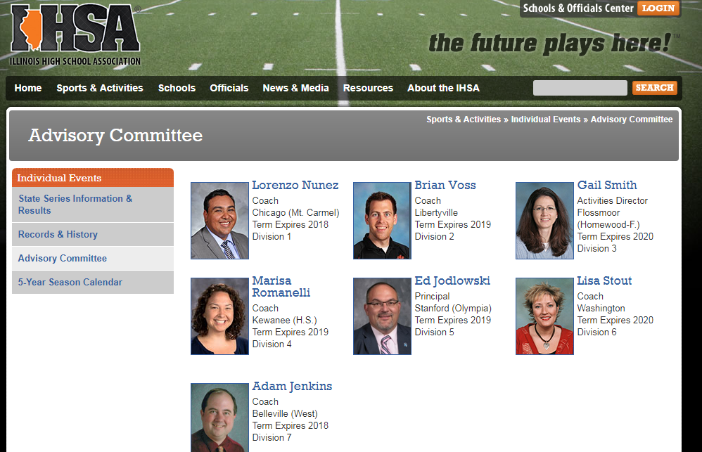
IHSA.org
Notes:
Service to our Advisory Committees
Coaches, Directors, Principals, Activity Directors
Look for those who cross over in service

Slide 7
State Final Managers
Member School Coaches & Participants
Advisory Committee
State Final Manager
IHSA Administrator

Slide 8
State Final Managers Role & Responsibilities
Lainee McGraw – Debate
Jan Heiteen – Speech – Individual Events
Pat Wozny - Drama

Slide 9
So How do you “Make Leaders Out of Coaches.”
Look for those who cross over in service
Place coaches in leadership roles to observe their style
Stay open to feedback from your coaches
Stair step development
Ask good – powerful questions
Takes a positive approach
Commits to continuously learning
Teach and Train
Create Emotional Safety
Ownership
Actively Listen
Educate yourself about your coaches and then empower them
Model the behavior you expect
Have “Check-In’s” – Active Meeting
Notes:
Stay open to feedback from your coaches
Be ready to think outside of your comfort zone
Build goals/roles around strengths:
Look for those who cross over in service
Place coaches in leadership roles to observe their style
Stay open to feedback from your coaches
Stair step development
Ask good – powerful questions
Takes a positive approach
Commits to continuously learning
Teach and Train
Create Emotional Safety
Ownership
Actively Listen
Educate yourself about your coaches and then empower them
Model the behavior you expect
Have “Check-In’s” – Active Meeting

Slide 10
How to Make Leaders Out of Coaches
In summary, leadership is an intriguing topic. There is no one way to lead and what works for one may not work for all. Research can aid in assisting coaches with tried and true practices.
The most important concept a leader/coach can apply is gaining an understanding and knowledge of your coaches first and foremost. Once you have gained that you will be able to assist them in reaching their goals.
Notes:
In summary, leadership is an intriguing topic. There is no one way to lead and what works for one may not work for all. Research can aid in assisting coaches with tried and true practices.
The most important concept a leader/coach can apply is gaining an understanding and knowledge of your coaches first and foremost. Once you have gained that you will be able to assist them in reaching their goals.

Slide 11
How to Make Leaders Out of Coaches
Role
Example
Awareness
Passion
Enthusiasm
Ability
Communication
Motivation
Visionary
Notes:
Role
Example
Awareness
Passion
Enthusiasm
Ability
Communication
Motivation
Visionary

Slide 12
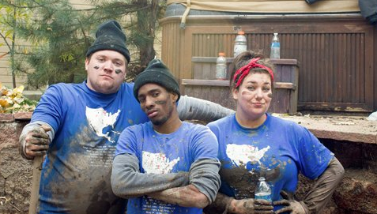
Not Afraid to Do the “Dirty Work”
Notes:
Not Afraid to Do the “Dirty Work”

Slide 13
Poised Under Pressure
Notes:
Poised Under Pressure

Slide 14
Looks Out for Others
Notes:
Looks Out for Others

Slide 15
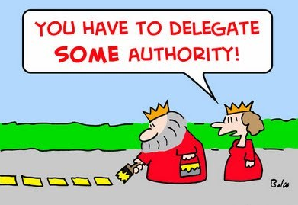
Delegate
Notes:
Delegate

Slide 16
Finds a Way to Make Thing Happen
Notes:
Finds a Way to Make Thing Happen

Slide 17
So Where Do I Begin?

Slide 18
Unify

Slide 19
Clarify

Slide 20
Simplify
Notes:
Simply tasks

Slide 21
Identify
Notes:
Do they need help, guidance, support, assistance, advise …

Slide 22
Leaders Can Become Better Coaches
Notes:
Who is at your leadership table?

Slide 23
The Best Leaders Are Great Coaches
Notes:
The Best Leaders Are Great Coach

Slide 24
How to Make Leaders Out of Coaches
Susie Knoblauch, IHSA Assistant Executive Director
Jan Heiteen, IHSA Speech: Individual Events State Final Manager
Notes:
How to Make Leaders Out of Coaches
Susie Knoblauch, IHSA Assistant Executive Director
Jan Heiteen, IHSA Speech: Individual Events State Final Manager
What would your program be like if you were the person who came to mind every time someone said they need X, Y, and Z? Becoming the go-to person in your profession takes consistent, clear, and laser-focused effort. And it is our job to make leaders out of the coaches in our states. You must be bold in your beliefs and teaching, and you must be seen as a resource in your community. Sound difficult? It’s not difficult, but it takes getting a few things nailed down with crystal-clear precision and accuracy, so that people know EXACTLY what you do and who you serve.

