Slide 1
Project Management Tools:
For Your Sanity and Their Empowerment
Kevin J. Berlat, and Kimberly Bayan-Berlat – Mesa HS
National Performing Arts Conference 2019

Slide 2
Our Dilemma
The Team: Small scale, large time commitment.
The Tournaments: Large scale, limited resources.
SWSD: High quality, limited time.
The Berlats: Two points of view, not enough overlap in time or place.

Slide 3
Why Project Management Tools?
National Performing Arts Conference 2019

Slide 4
The Real World
The future of work is collaboration due to advancements in technology and the rise of project-based work.
Industries in need of PMs: Engineering/Construction, Financial Services, Technology, Healthcare, Law
Soft Skills for Successful PMs: Leadership, motivation, communication, conflict management, trust building, decision making, and organization.

Slide 5
And Then, There’s YOU
As teachers, sponsors, directors, and coaches, we often fall into the trap of doing everything for the kids.
Running a program provides an opportunity to teach leadership skills, but we sometimes lack the tools.
You deserve some kind of break too ☺

Slide 6
The Tools
National Performing Arts Conference 2019

Slide 7
But First…A Little Framework
All projects have the same buckets of work:
Planning
Executing/Tracking
Review
What is Agile Framework?
An approach to project management commonly used in software development.
The methodology focuses on iterative development and growth through self-organizing and cross-functional teams.

Slide 8
But First…A Little Framework
But what does that have to do with us?
By stripping down some of the popular tools used in Agile, teachers/coaches can use them as the push to organize and develop their students.

Slide 9
USING SCRUM FOR PLANNING
What is SCRUM? An Agile planning methodology that is used to primarily delivery software products.
What are the main ideas?
Delivery is done in pieces (2-4 weeks at a time)
Scrum has defined team roles, events, and rules
Focuses on delivery within a scope of time
What can you use it for on your team?
Creation and delivery of competition material
Planning team events/tournaments
Allows for continuous feedback

Slide 10
SCRUM KEYS
SCOPING
CONSISTENCY
RETROSPECTIVE
How long is the sprint?
What are the tasks?
What is the end result?
When is it feasible to be done?
Is real progress being made?
Do you have to adjust?
Are we still within scope?
Are we just going through the motions?
What went right?
What went wrong?
What can we fix now?
What can we do better?

Slide 11
SPRINT PLANNING
Determine what needs to be done and in what amount of time. Helps to work in phases.
DAILY SCRUM
A daily meeting to determine what has been completed and what has a roadblock. (In our activity, maybe this isn’t daily, but it should be consistent.)
SPRINT REVIEW
Review what was completed. What was not completed is marked as “backlog” and will be included in the next sprint.
SPRINT RETROSPECTIVE
Discuss what went right and what didn’t. Discuss if improvements can be made.

Slide 12
SPRINT PLANNING EXAMPLE
WHAT DO YOU WANT TO DO?
Complete a first draft of Info speech.
Be specific and be honest. Scale to the person.
WHEN DO YOU WANT IT DONE?
September 30, 2019
Instead of big chunks, try shorter “sprints.”
WHAT ARE THE TASKS & WHO DOES THEM?
Outline, get outline approved, research, plan visual aids, write full draft.
List the tasks that need to be done and prioritize.
Define what is “done.”

Slide 13
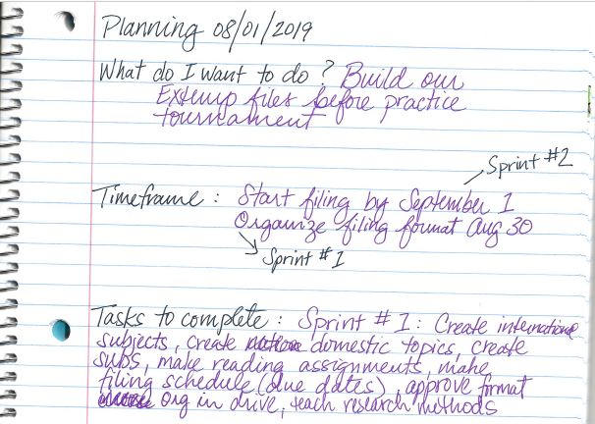
Example Notebook Sprint – Oratory and Extemp Box Prep

Slide 14
Sprint Planning Exercise
Using Scrum as your planning method, select and plan something related to Performing Arts or your work life.

Slide 15
USING KANBAN FOR EXECUTION/TRACKING
What is Kanban? A work management system that is favored by Agile/Scrum users. Japanese for “visual signal.”
What are the main ideas?
Three Columns: To Do, In Flight, Done
PULLING tasks vs. assigning tasks.
A Kanban Board makes work/progress visual
What can you use it for on your team?
Organizing any task based activity (e.g. tournament planning, event creation).

Slide 16
KANBAN KEYS
KEEP IT SIMPLE
KEEP IT VISIBLE
KEEP ON TRACK
Kanban cards are like tag lines
Only write it down if it’s part of the project.
Manual or electronic
Visibility keeps work at the forefront
Update in real time
Anyone can pull tasks
Everyone is responsible

Slide 17
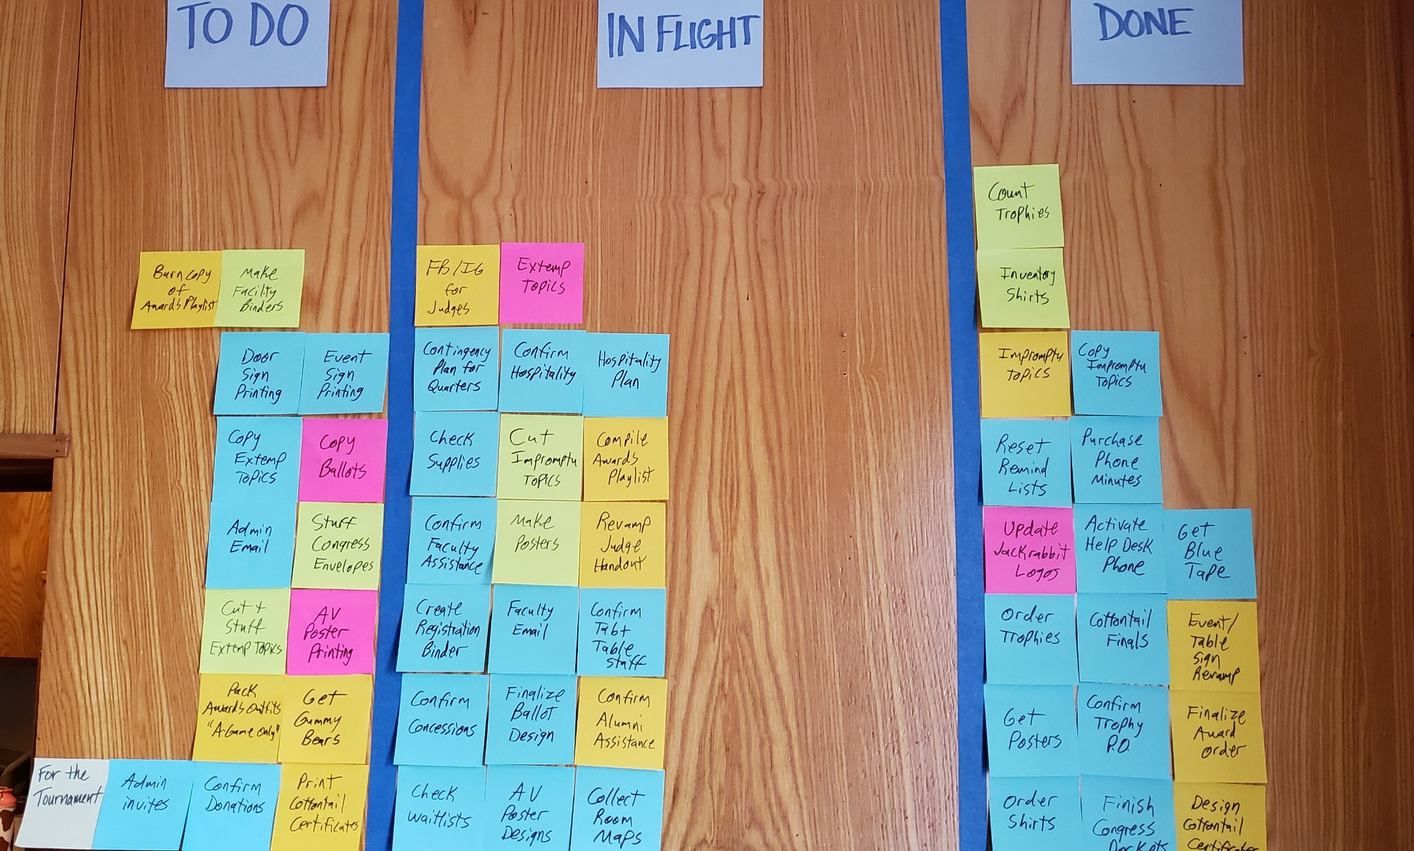
The Jamboree Kanban
Simple, Visible, and Trackable!

Slide 18
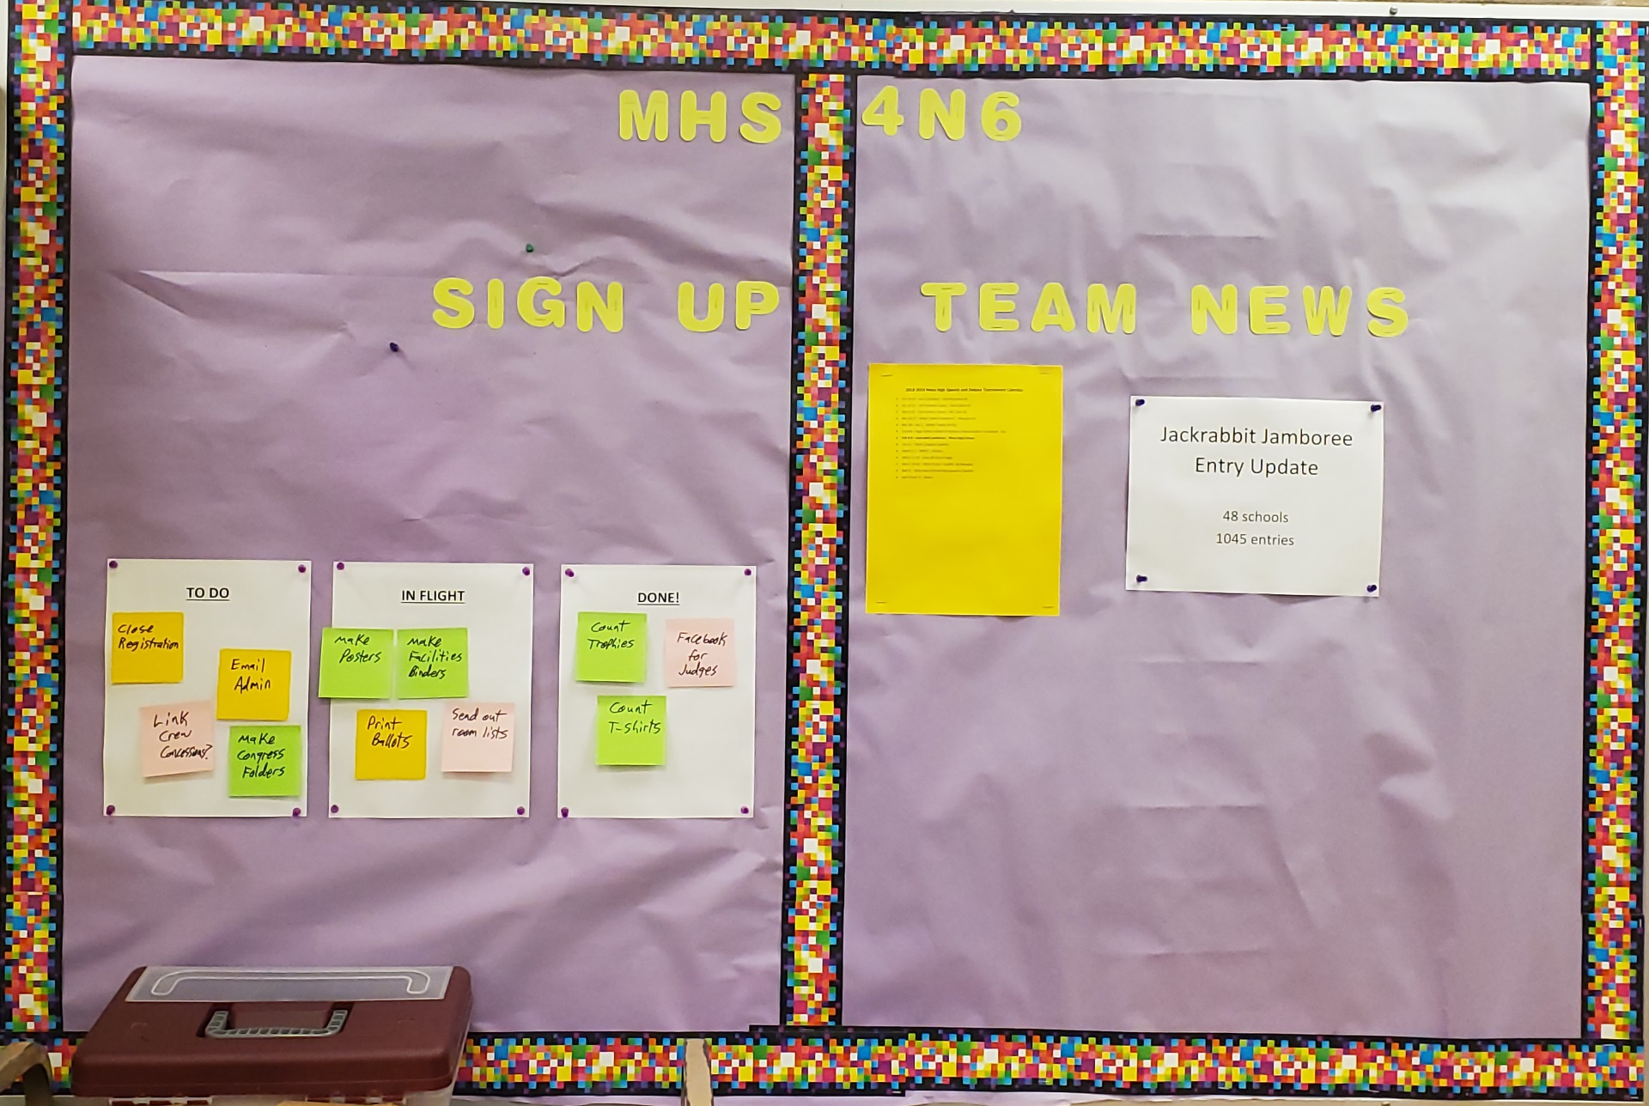
It Doesn’t Have to Be Fancy

Slide 19
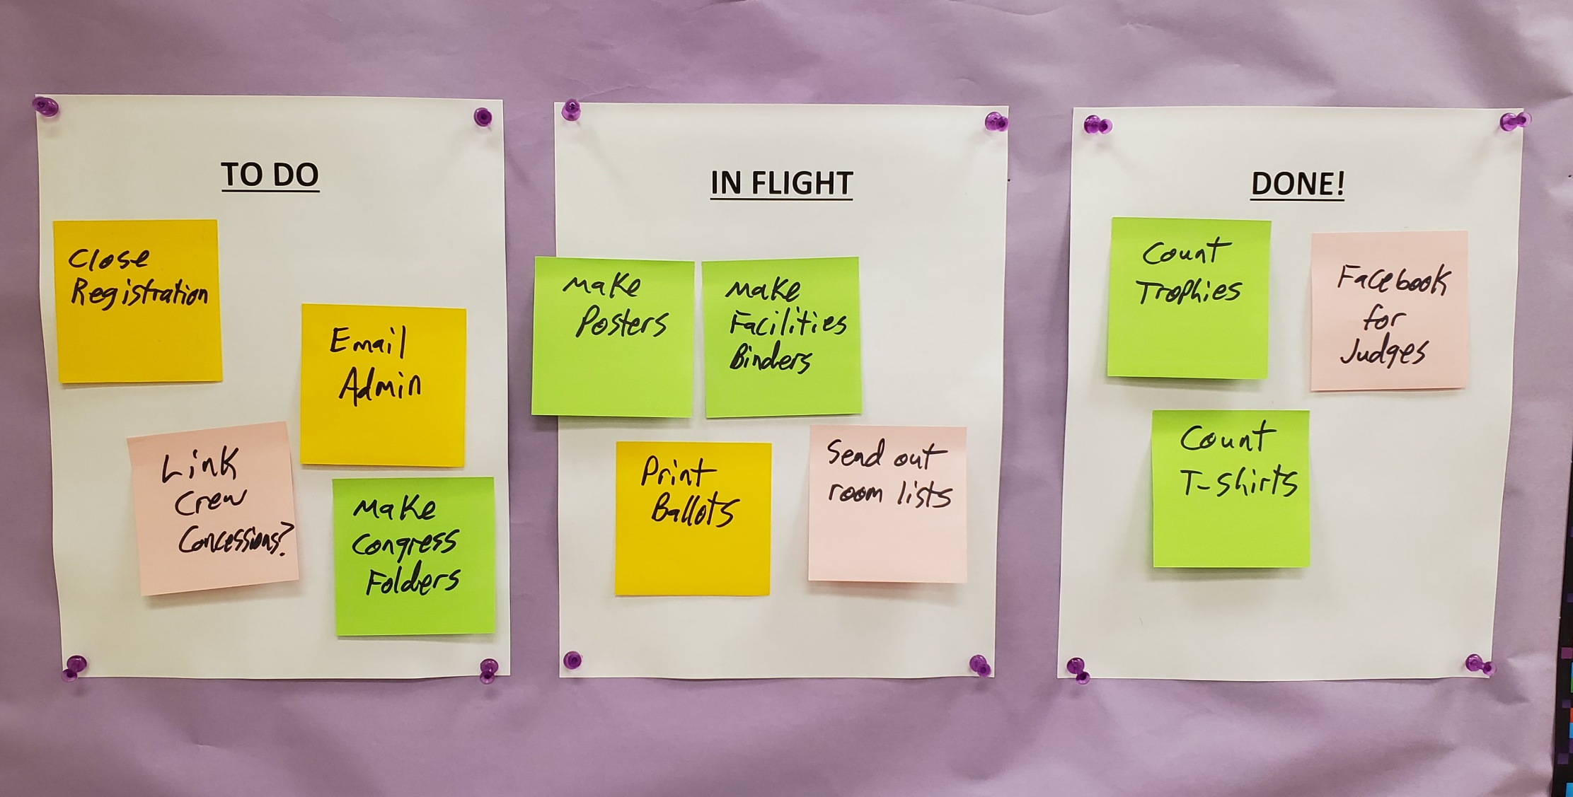
It Doesn’t Have to Be Fancy

Slide 20
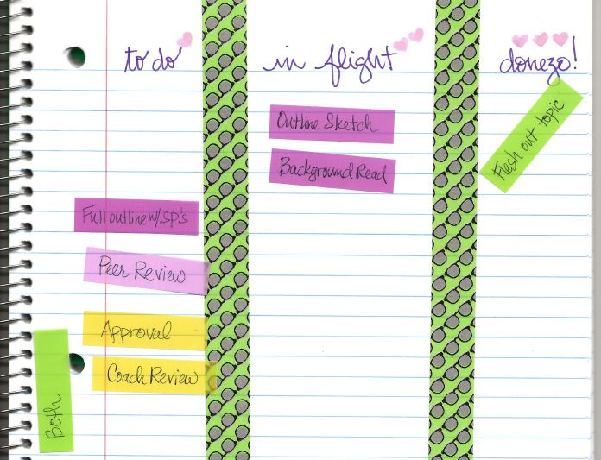
Example Notebook kanban - Oratory

Slide 21
Kanban Exercise
Using the materials provided, create your own Kanban Board.
Create three columns with “To Do,” “In Flight,” and “Done.”
Populate the board with the To Do Tasks for your project.

Slide 22
USING KATA FOR REFLECTION
What is Kata? Literal meaning is “form” in Japanese. In project management, a structured way of review.
What are the main ideas? The Five Questions:
What is the target condition?
What is the actual condition?
What are the obstacles preventing the target condition?
What is the next step?
When will we review after the next step?

Slide 23
USING KATA FOR REFLECTION
What can you use it for on your team?
Post practice/competition reflection
Team culture building
Encourages continuous and lasting improvement

Slide 24
KATA KEYS
BE CONSISTENT
BE HONEST
BE ACTIVE
Always make time, even if it’s just 10 minutes.
It helps if you do it sooner rather than later.
Only answer the question being asked.
Put down things that are reasonably actionable.
Look back on the notes to ensure you are making the correct progress.
Use notes as a guide to your planning.

Slide 25
KATA IN THE CLASSROOM
USEFUL FOR TEAMS
Design team culture
Determine leadership goals
Set expectations
USEFUL ON PER STUDENT BASIS
Reflection post sprint
Emerge/clarify personal goals
Review post practice/tournament results

Slide 26
Kata Exercise (On Your Own)
Think of a project or process you have just completed.
Answer the Five Kata Questions to reflect on what occurred.

Slide 27
KATA’S FIVE QUESTIONS
What is the target condition?
What is the actual condition?
What are the obstacles preventing the target condition?
What is the next step?
When will we review after the next step?

Slide 28
Resources & Articles
National Performing Arts Conference 2019

Slide 29
Articles
The future of work is collaboration according to “The End of 9 to 5 and the Future of Work” by Scott Maxwell
What industries need Project Managers & their skills? Check out “The Best Sectors for Project Management Jobs” from thebalancecareers.com
What are some of the top skills industries look for in their project managers according to Villanova Universities “7 Essential Soft Skills for Project Managers.”

Slide 30
PM Resources
SCRUM:
Video: “SCRUM is a Project Management Method”
KANBAN:
Video: “What is Kanban?”
Blog: “Using Kanban in the Classroom”
KATA:
Blog: “Toyota Kata” (All About Lean)
Book: Toyota Kata: Managing People for Improvement by Mike Rother

