Slide 1
Adjudication Sheets
How to make them fit!

Slide 2
Adjudication Sheets
There is no consensus between states.
Yet there are definite similarities.
This presentation will explore those similarities and differences and provide samples of the wide range of adjudication forms that exist as we travel from state to state.
MY WAY
YOUR WAY

Slide 3
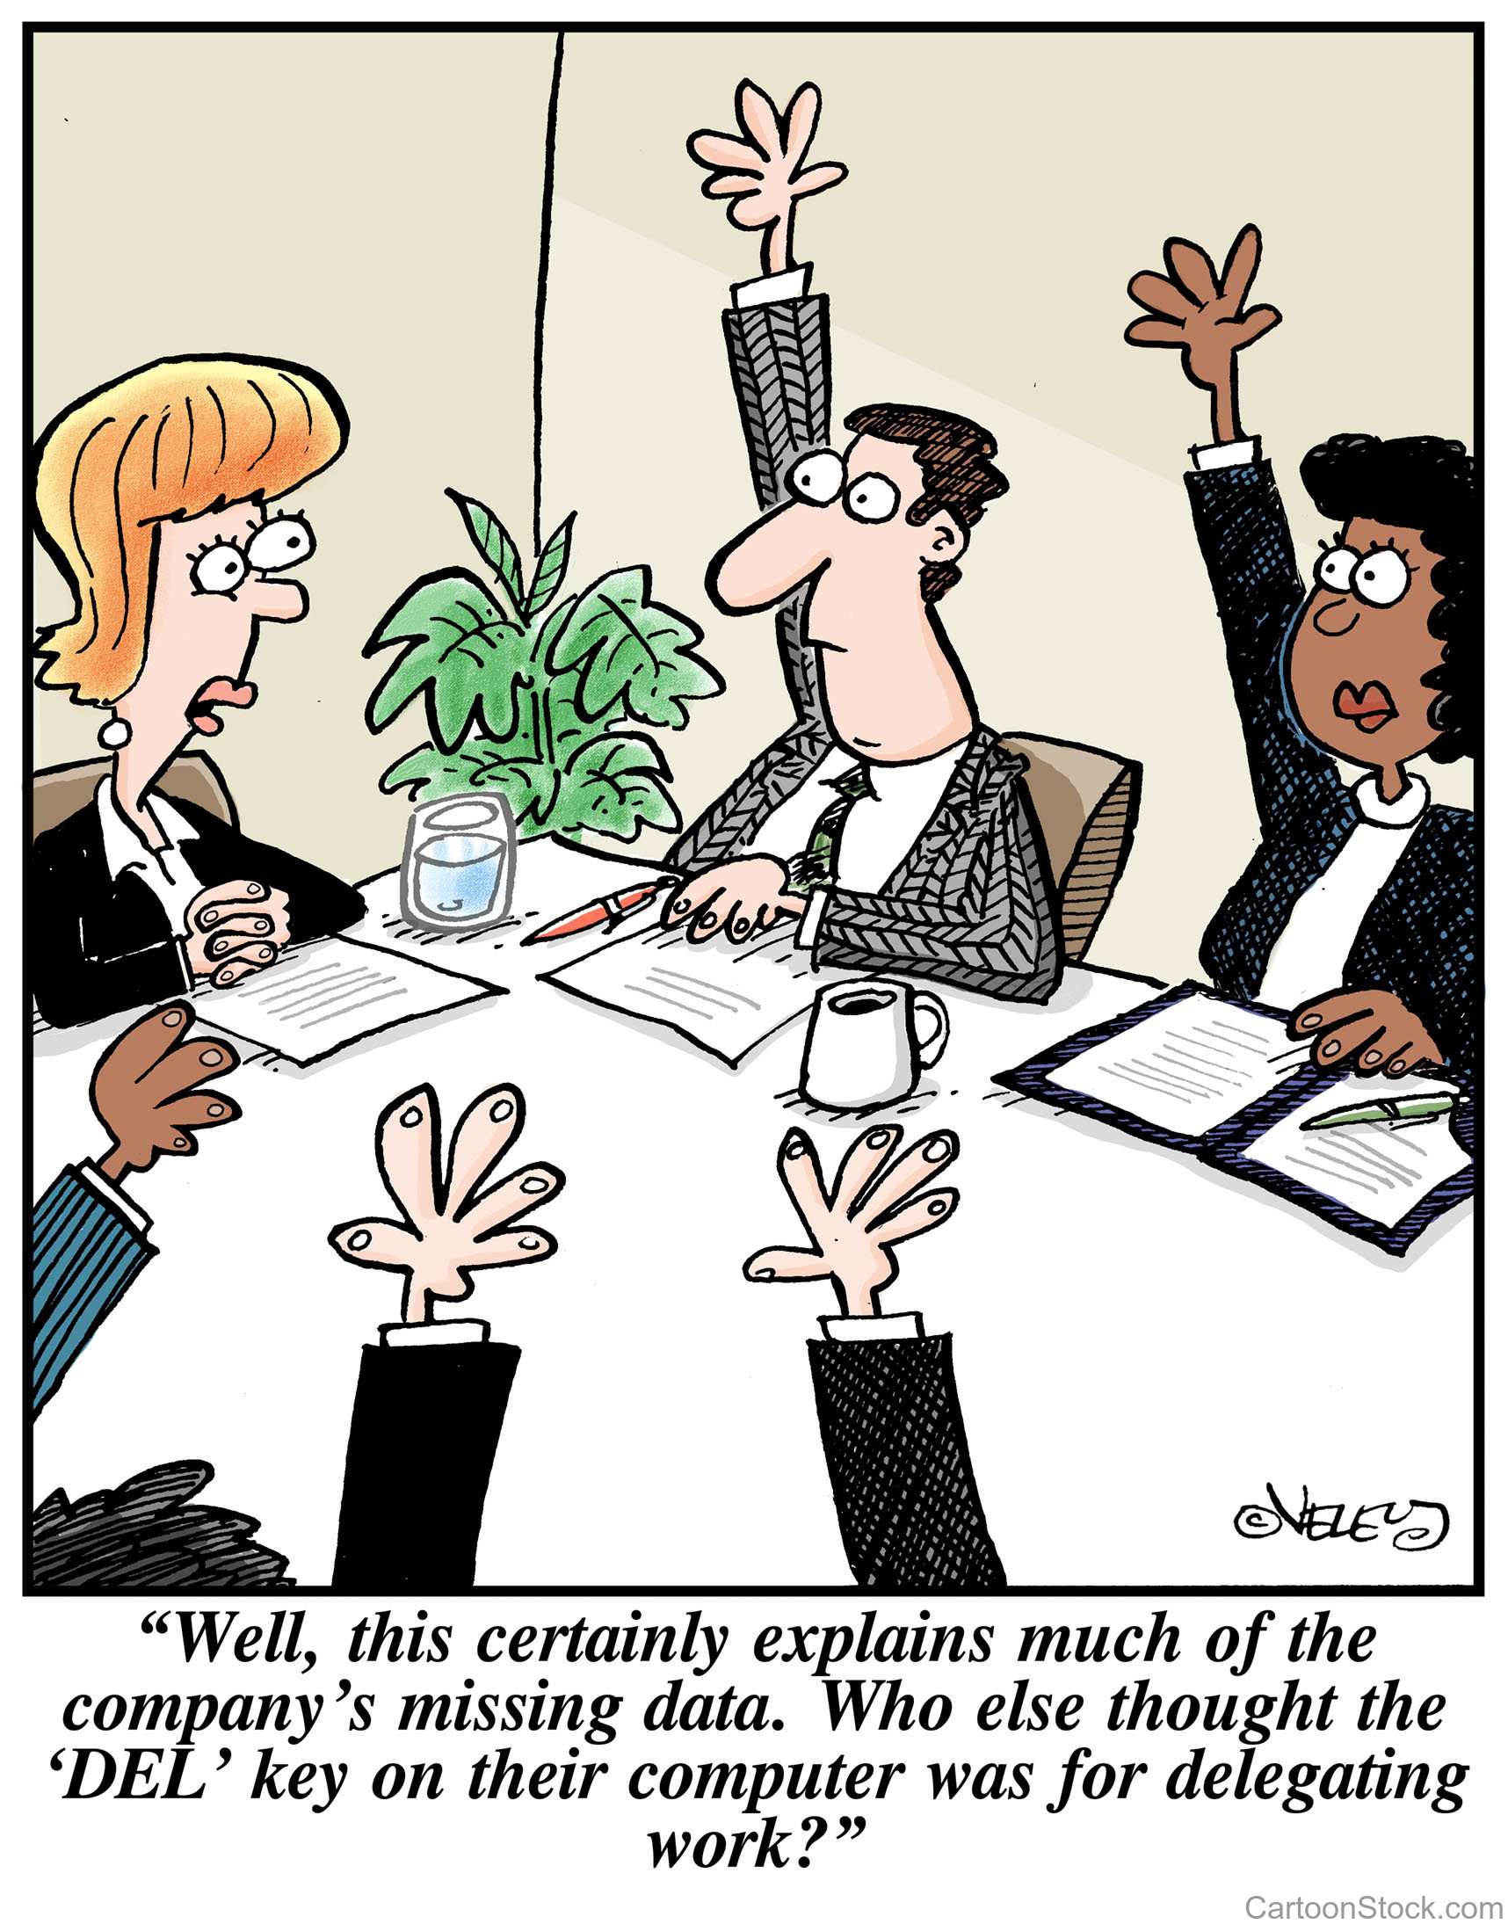
Adjudication Form - Development
Factors that inform the development of an Adjudication Form
Purpose – Festival vs. Competition
Philosophy – Divisional Ratings vs. Other System
Philosophy – Open Format vs. Rubric

Slide 4
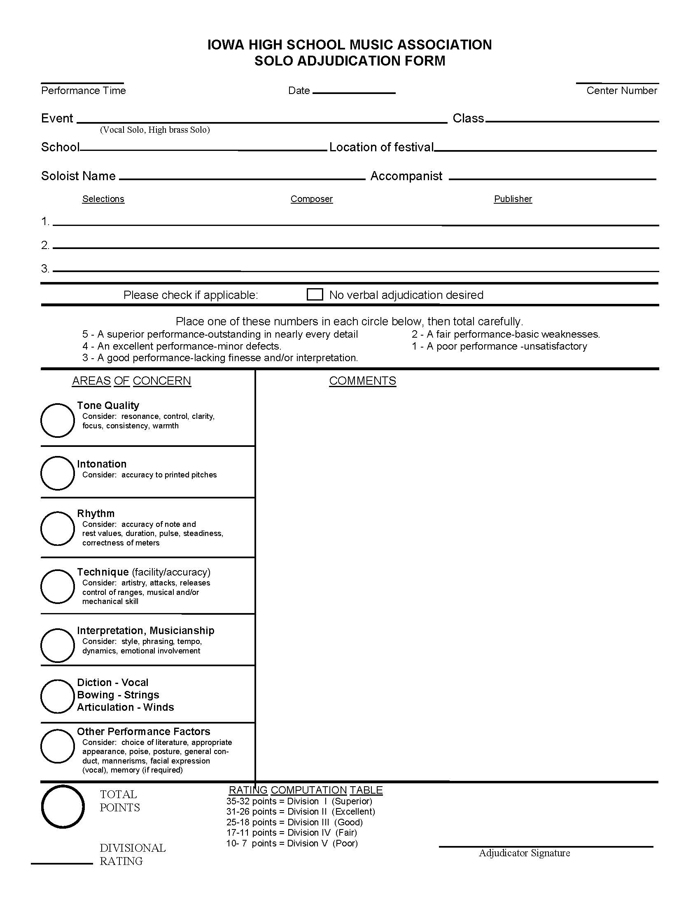
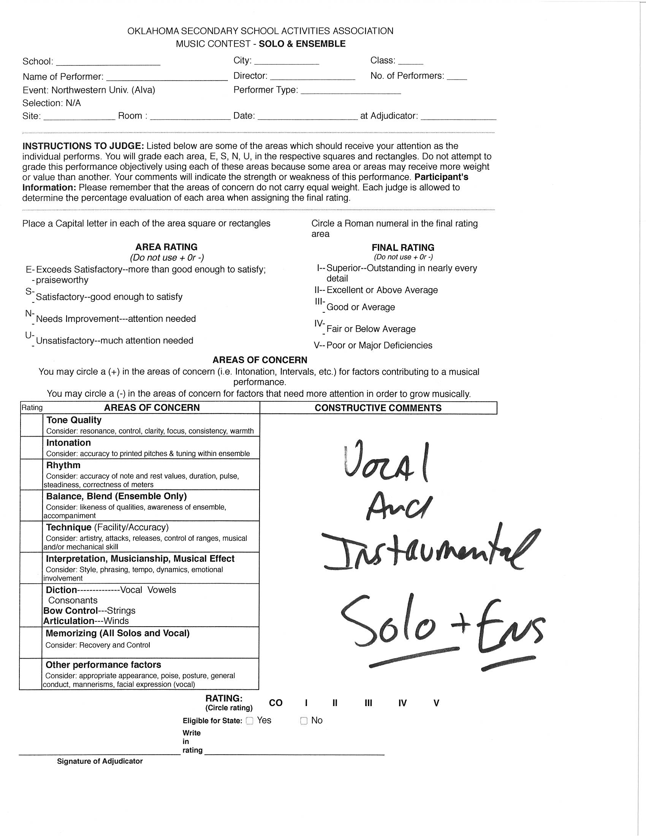
Adjudication Forms - Solo

Slide 5
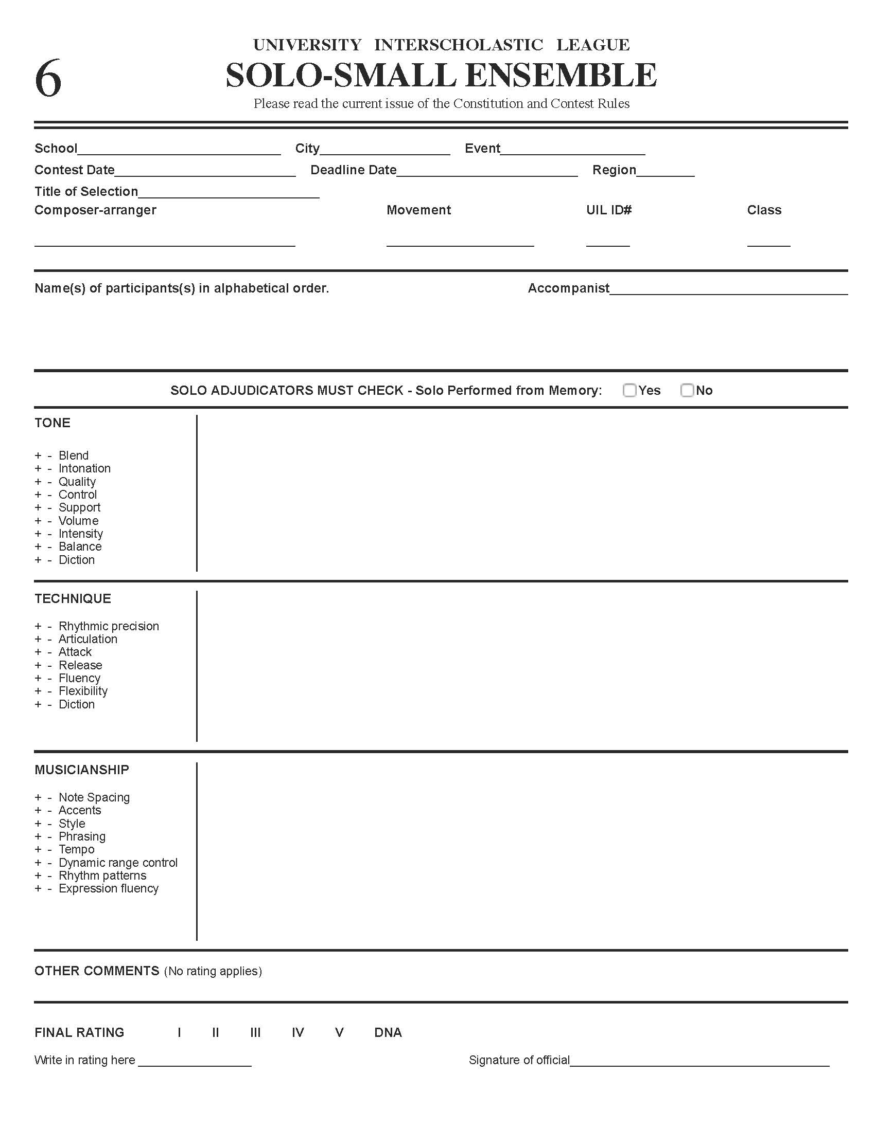
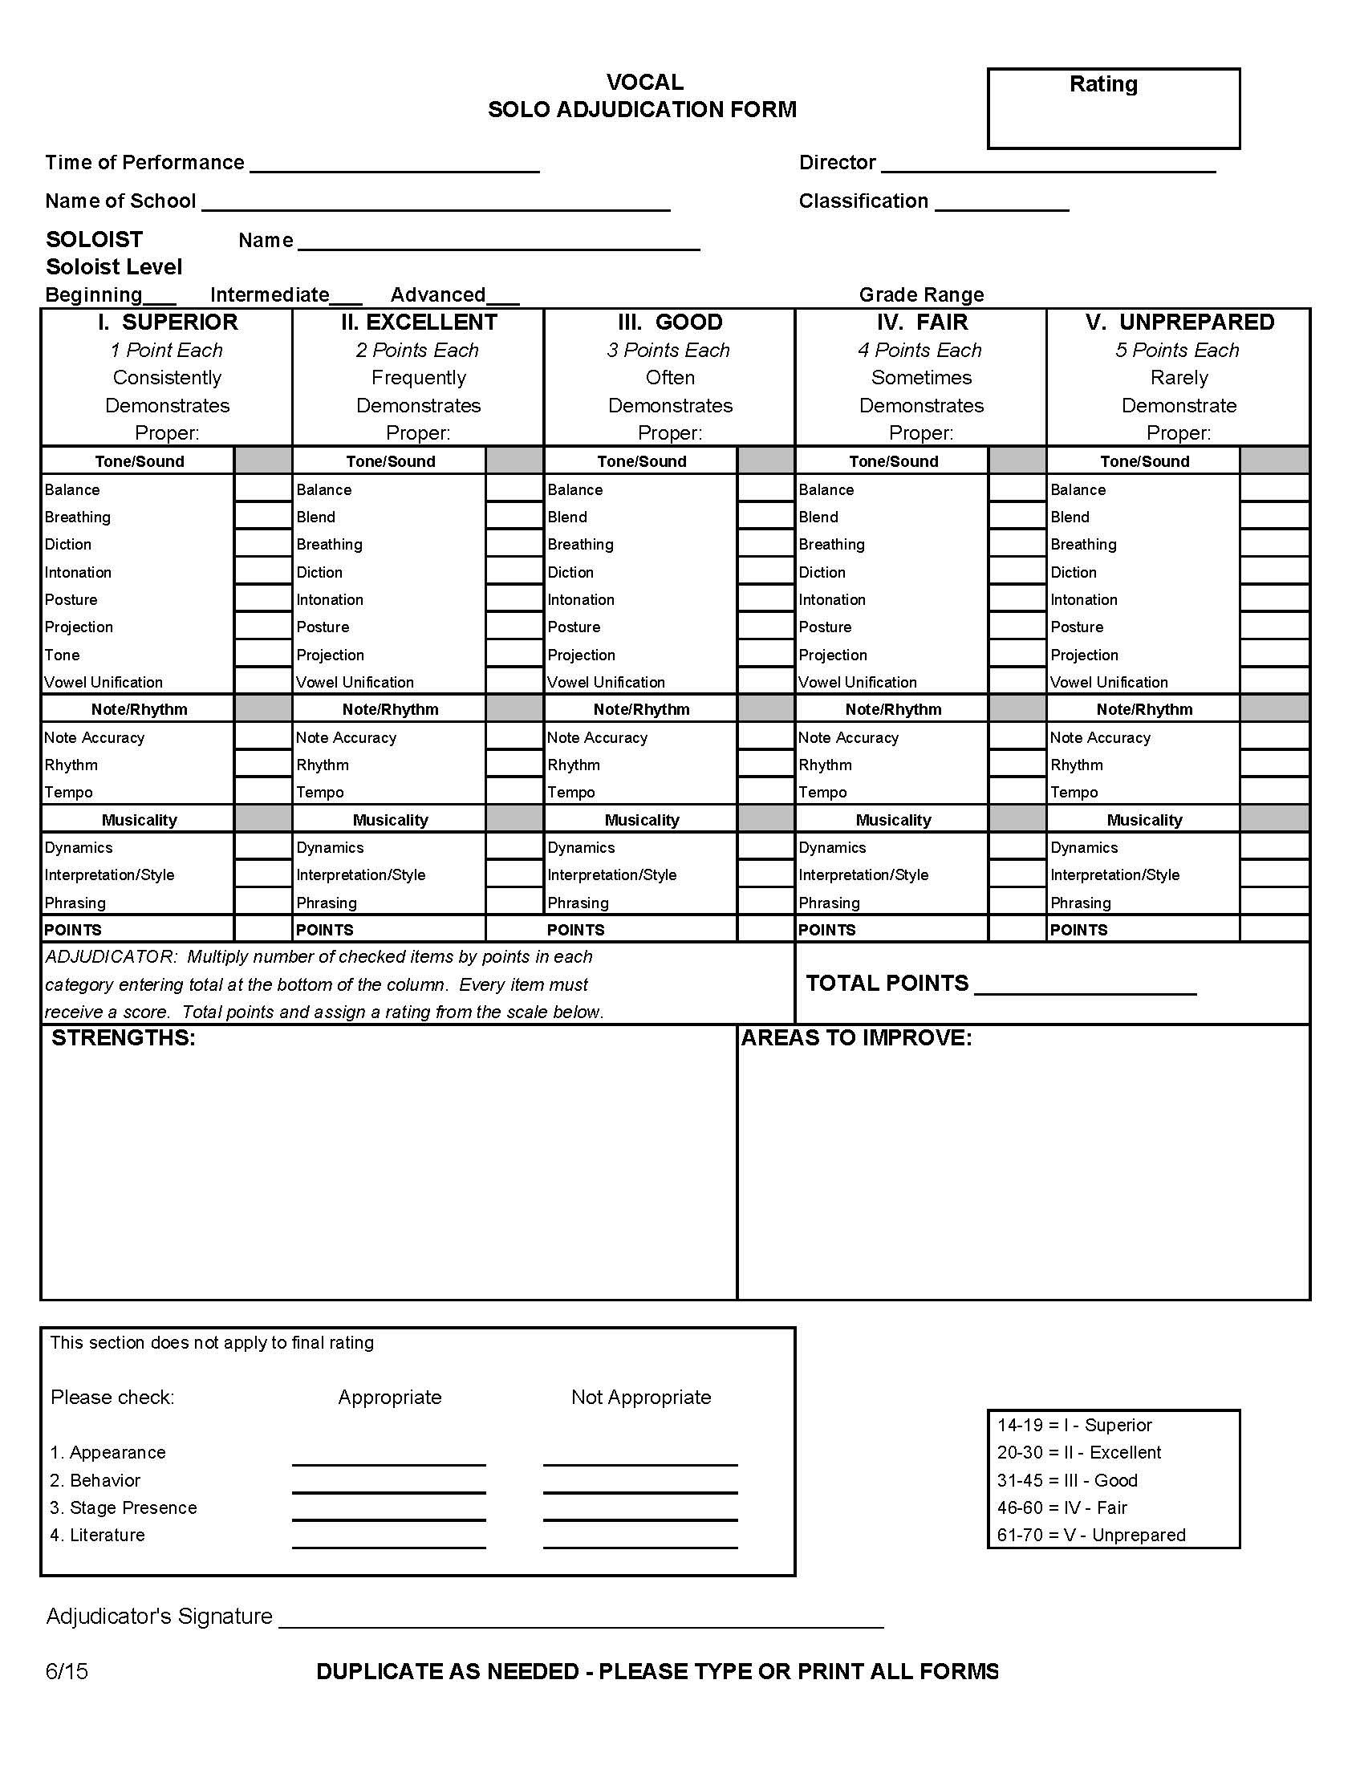
Adjudication Forms - Solo
Texas
Colorado

Slide 6
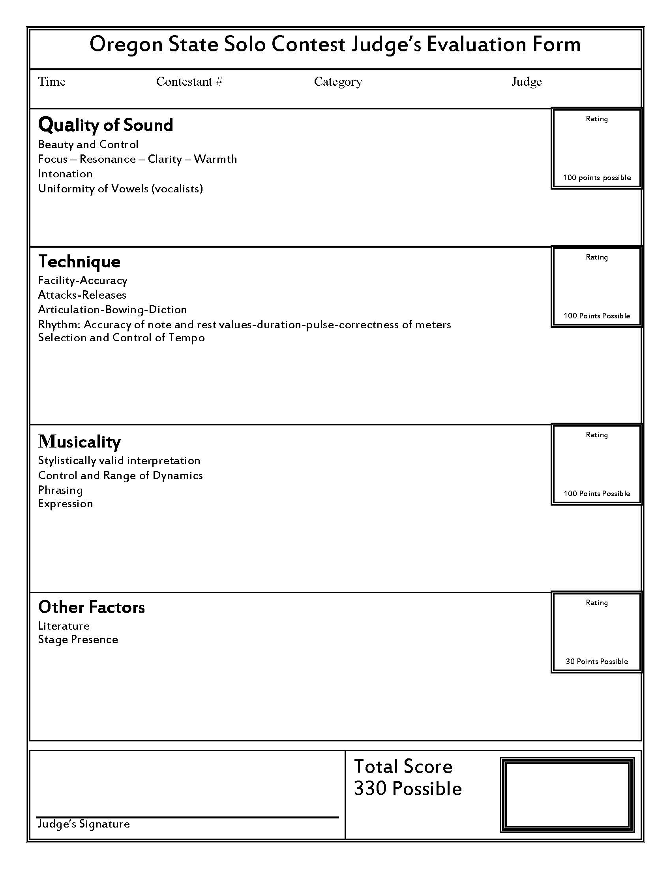
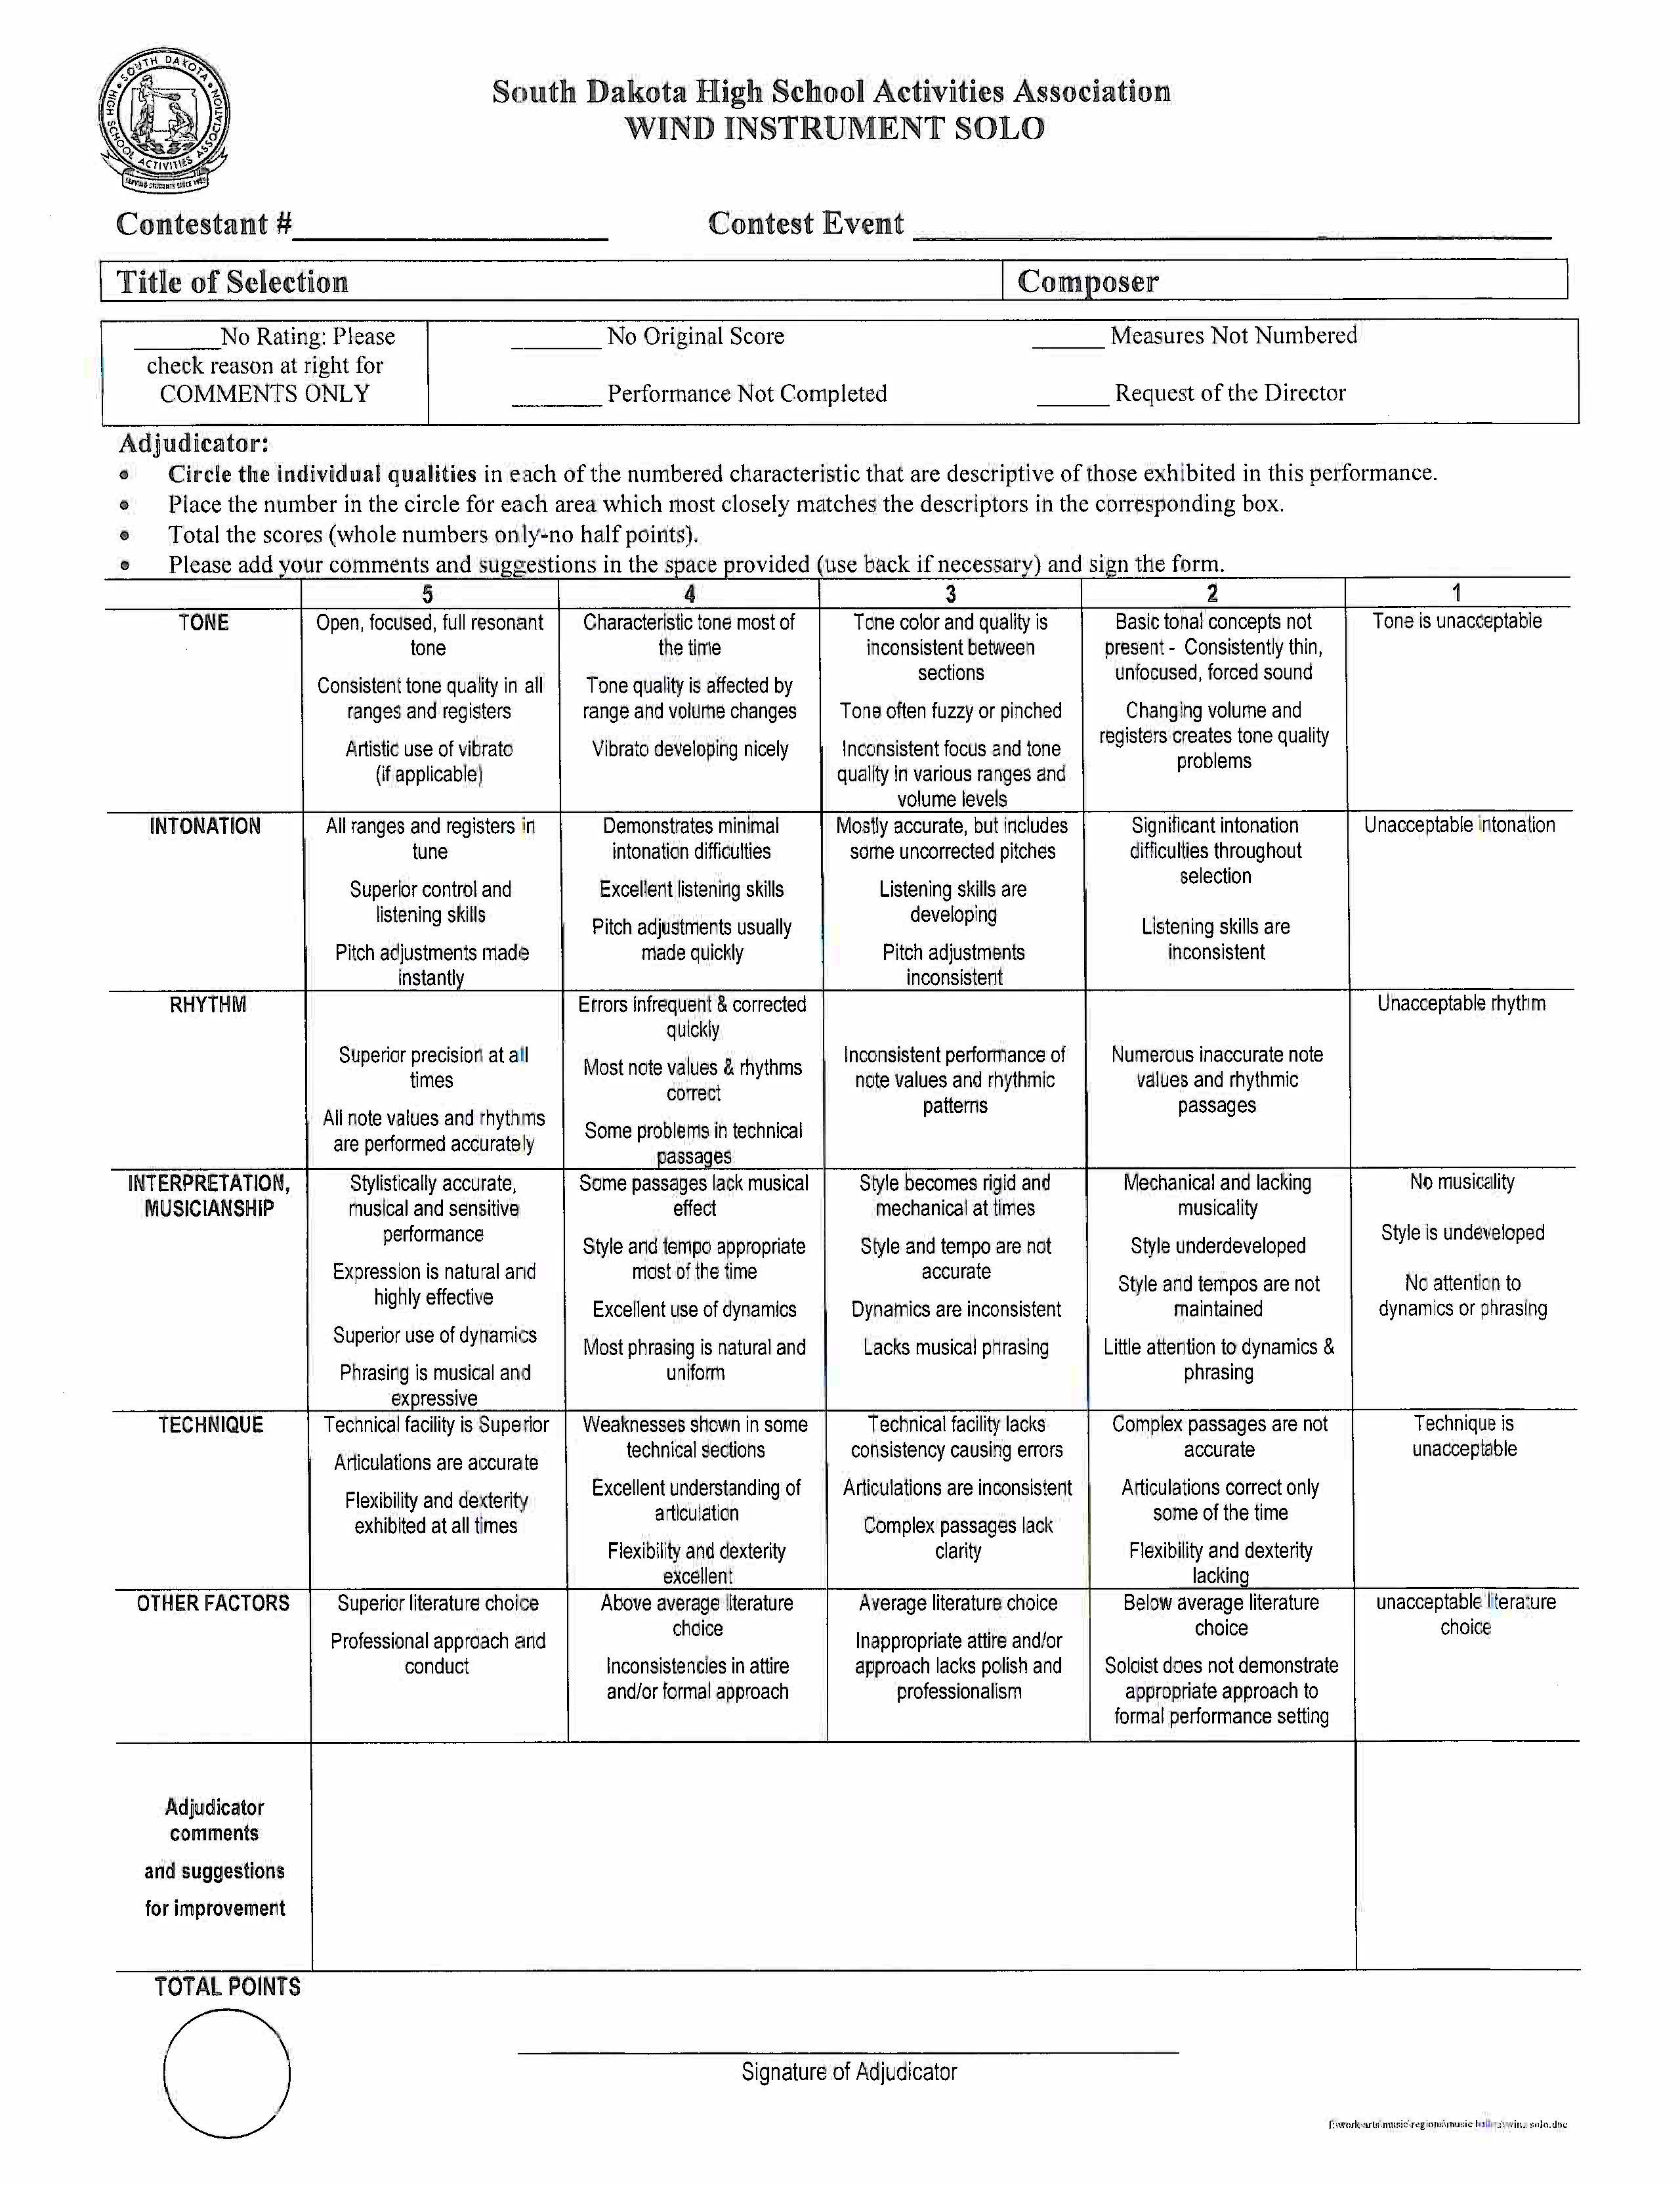
Adjudication Forms - Solo

Slide 7
Adjudication Forms - Solo
Kansas

Slide 8
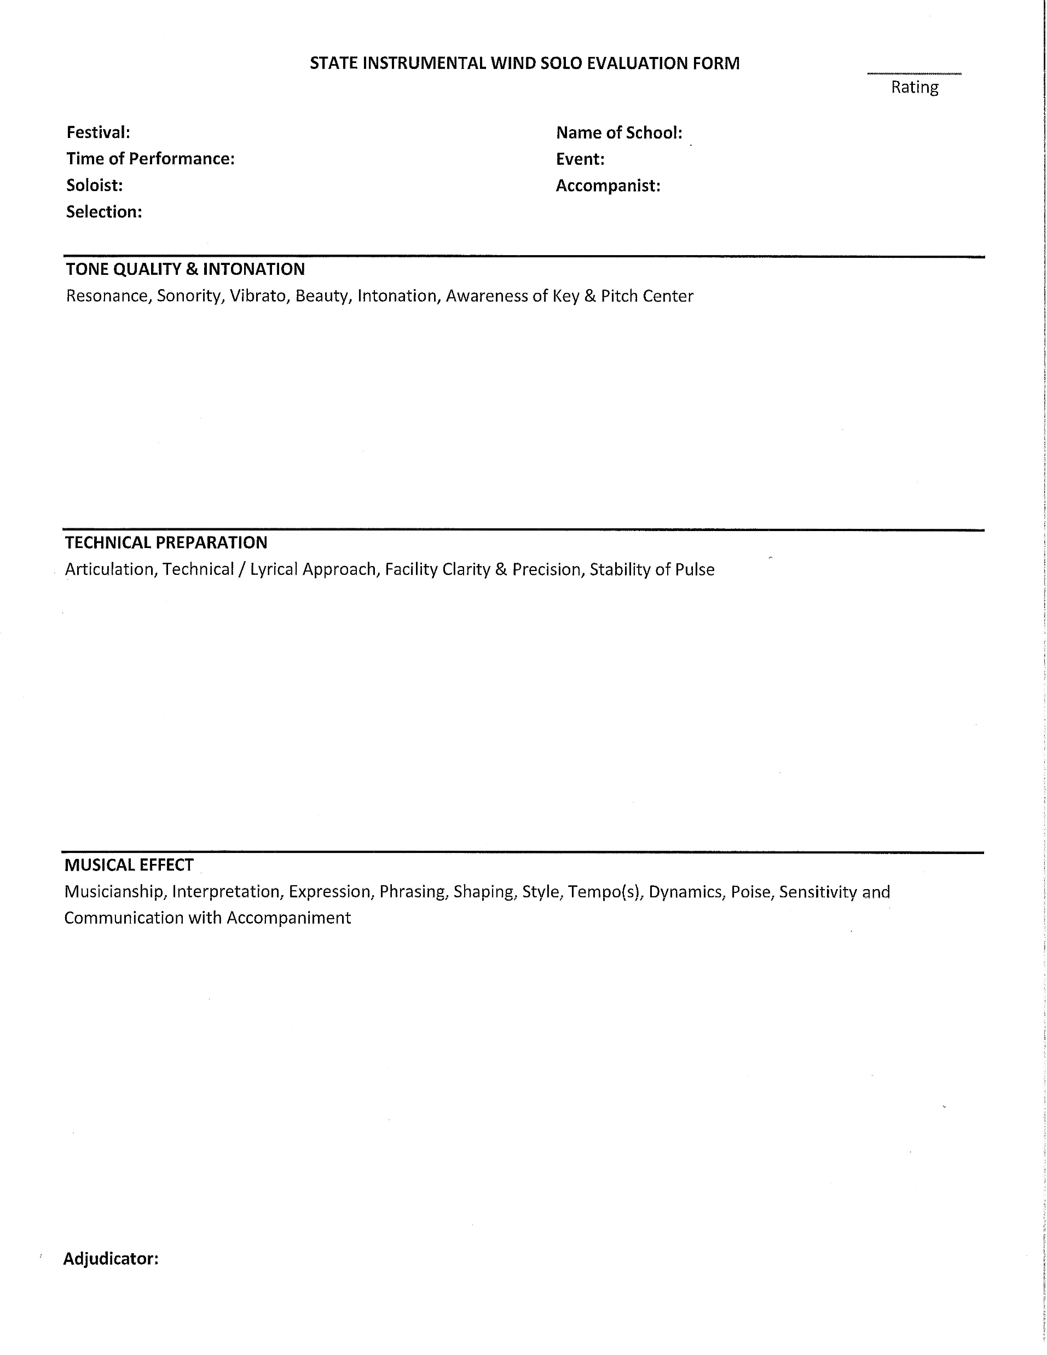
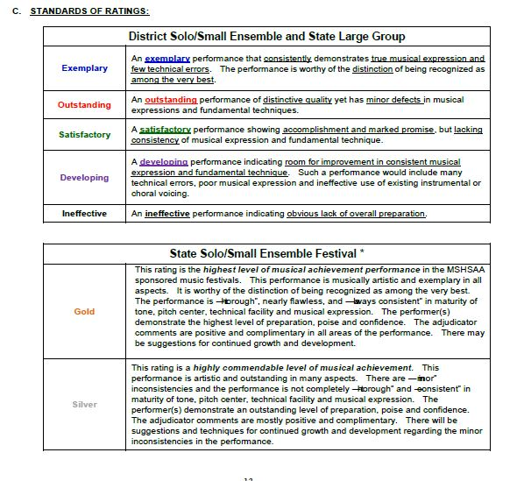
Adjudication Forms - Solo
Missouri - District
Missouri - State
Missouri – Standards (alt. to Div. Ratings)

Slide 9
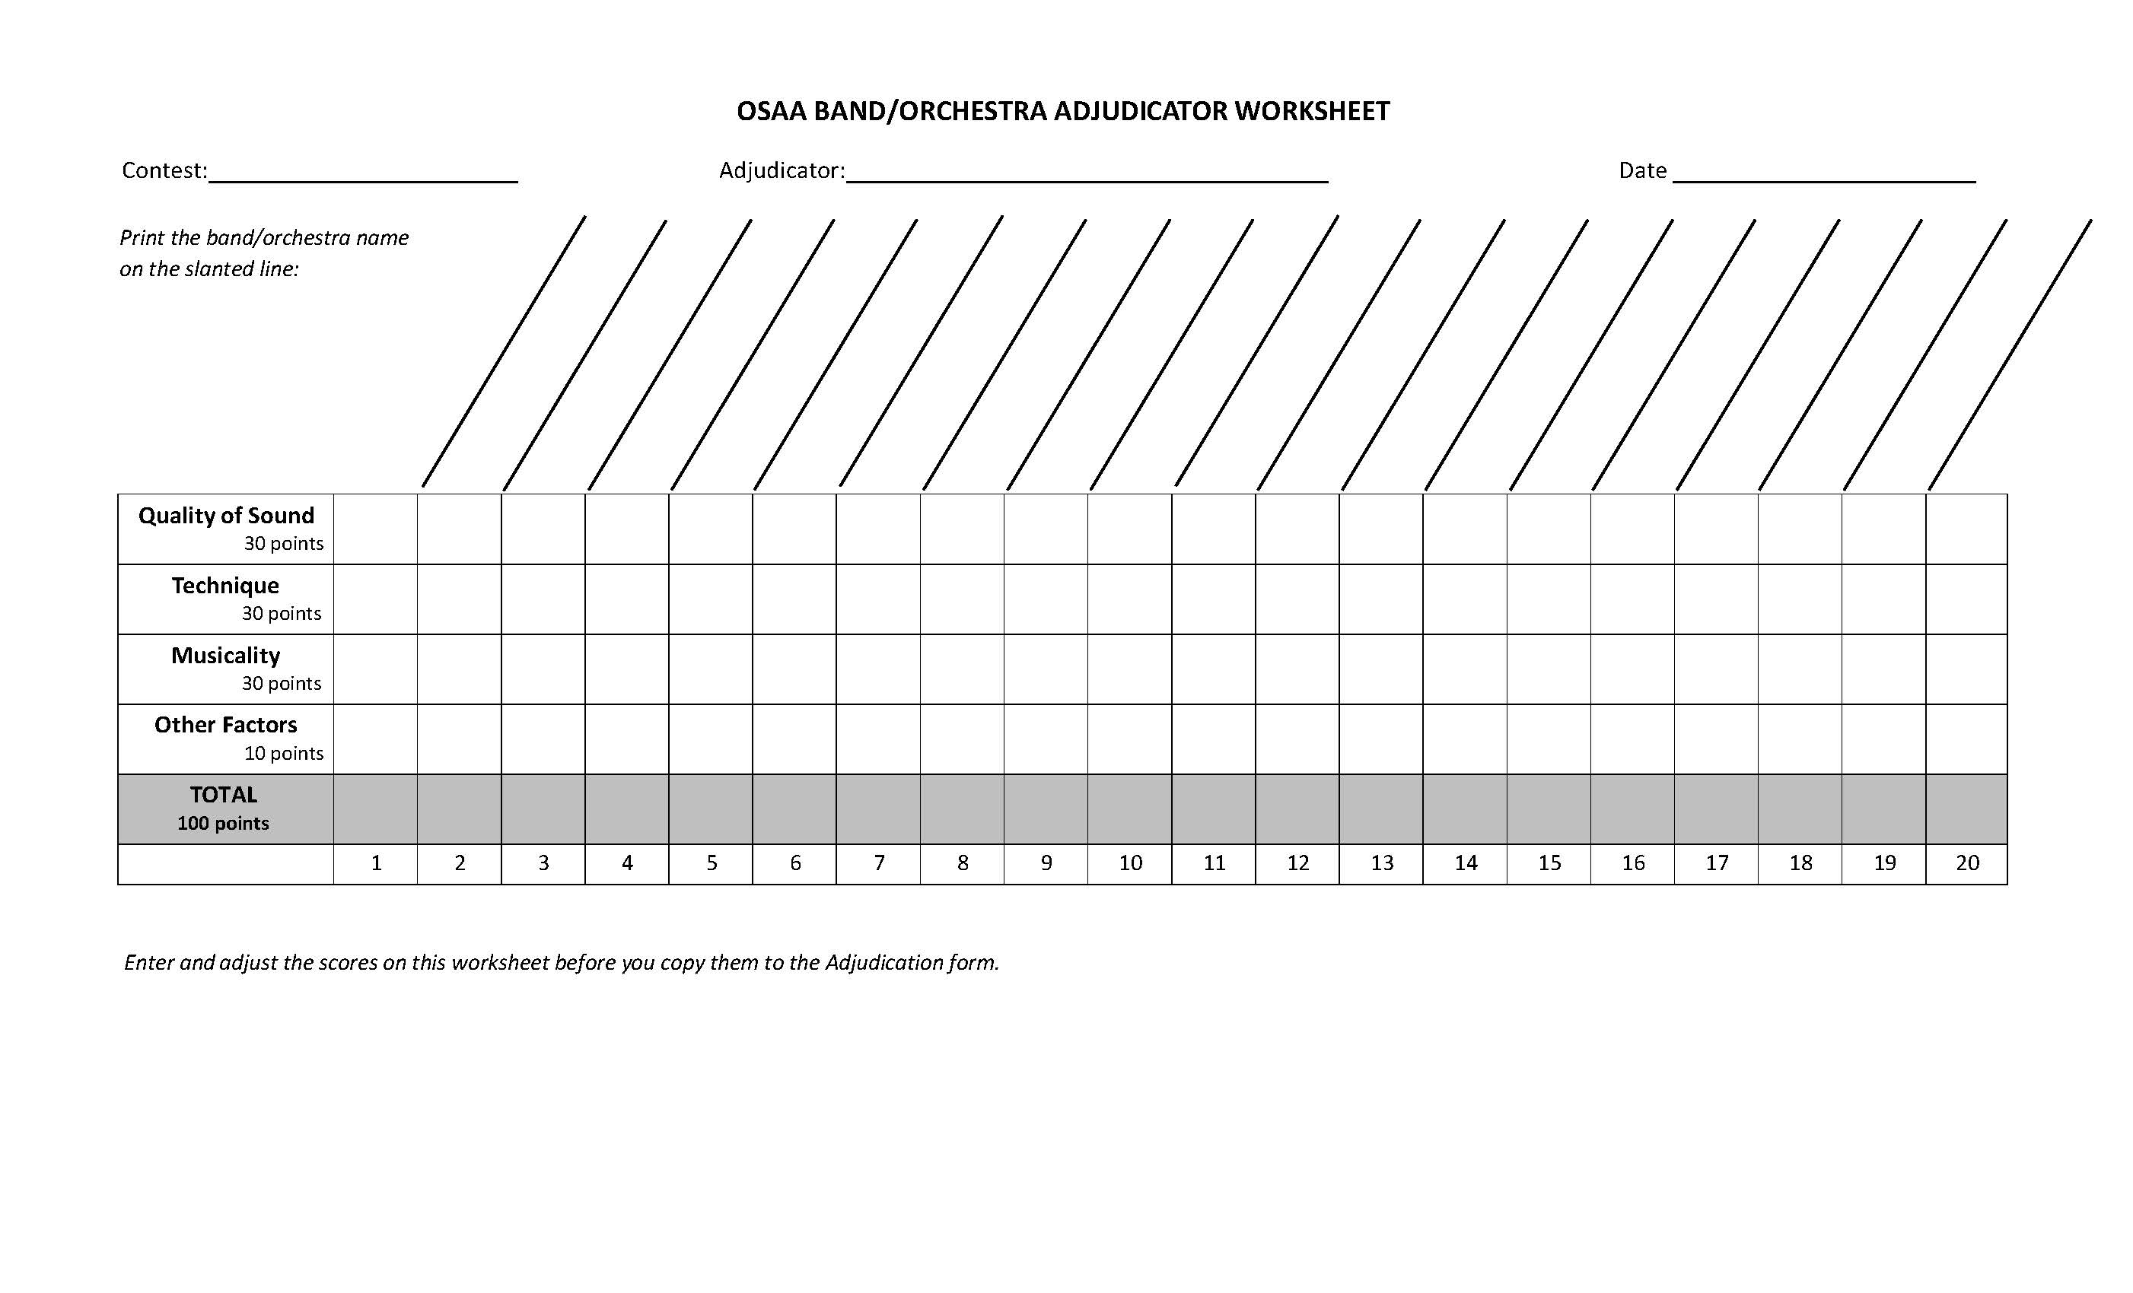
Adjudication Forms - Tools
Oregon – Judge Worksheet (tote sheet)

Slide 10
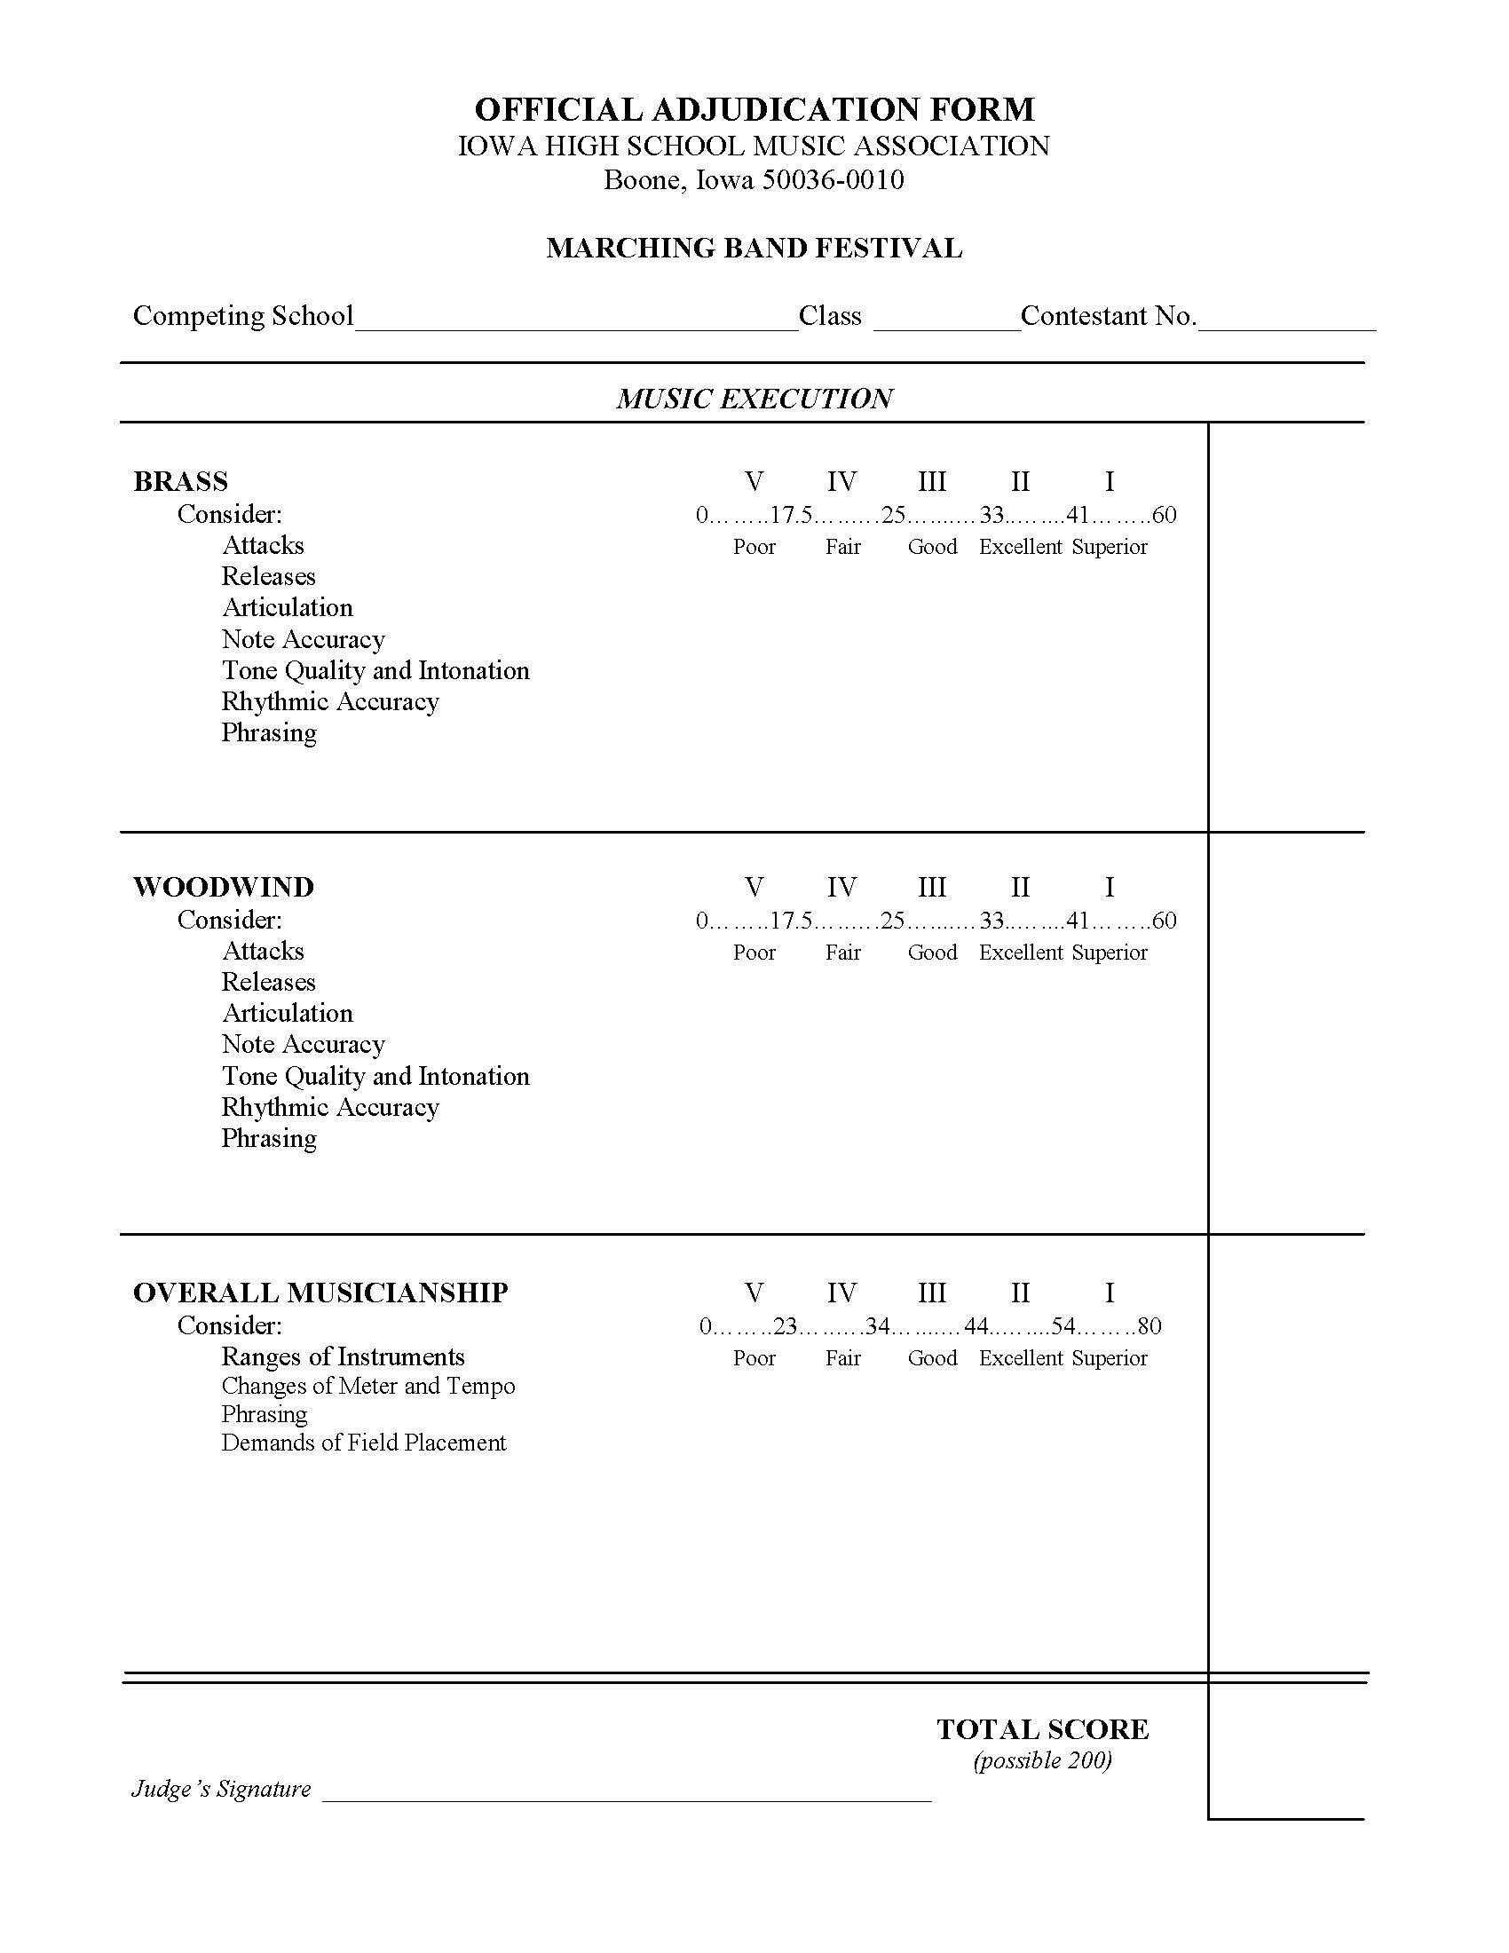
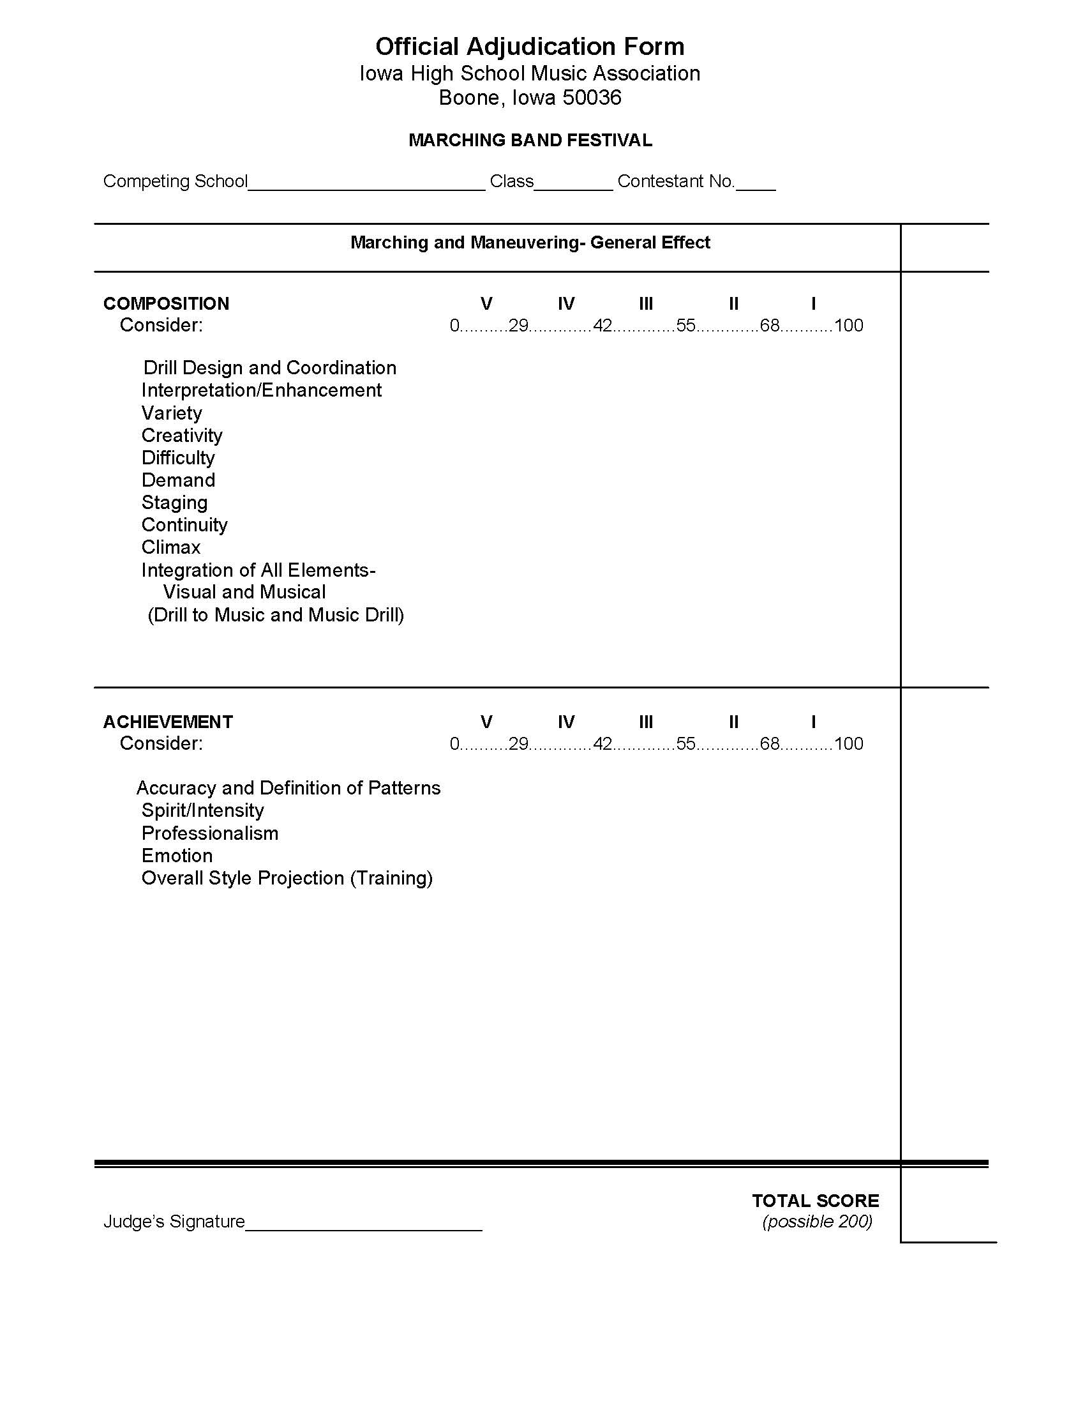
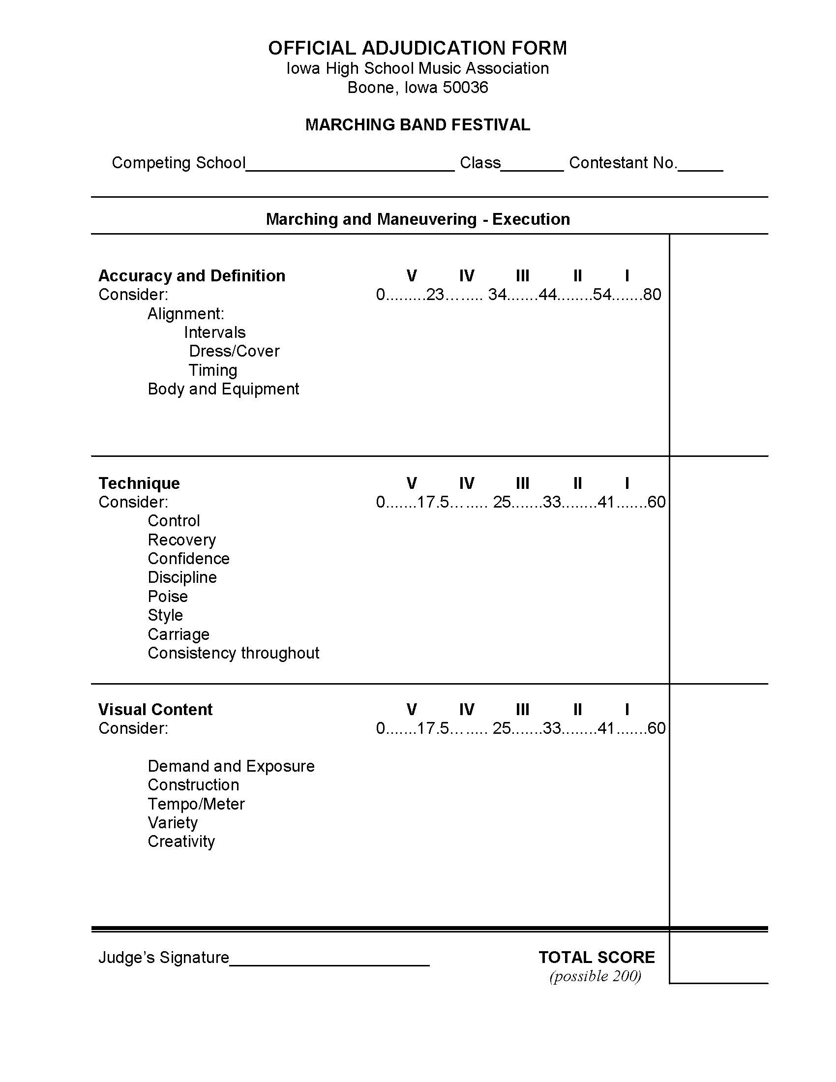
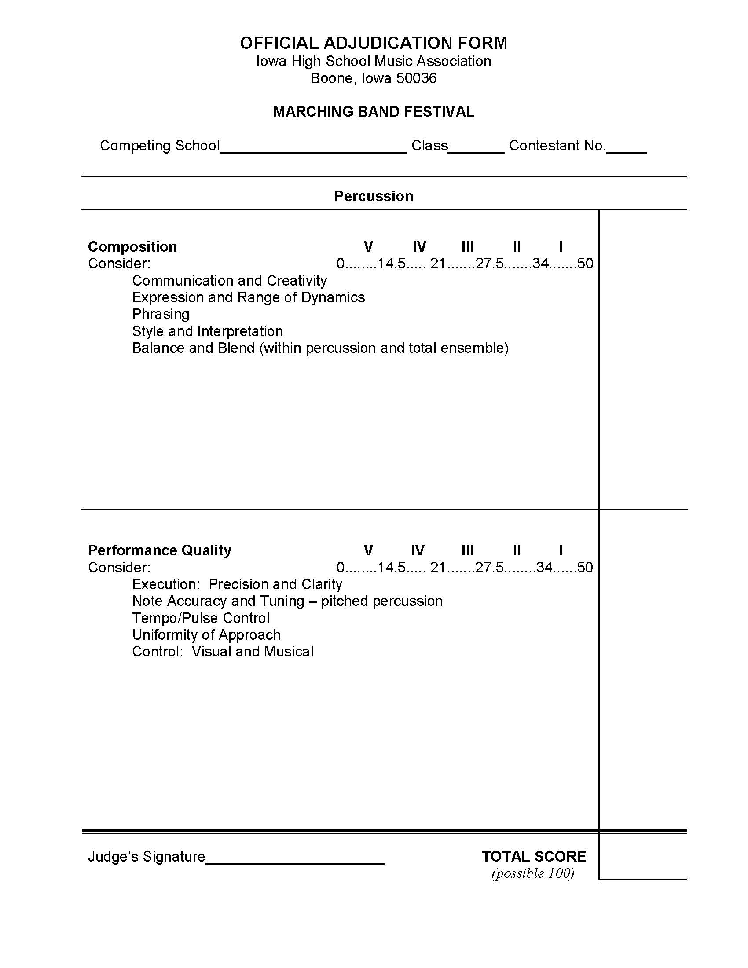
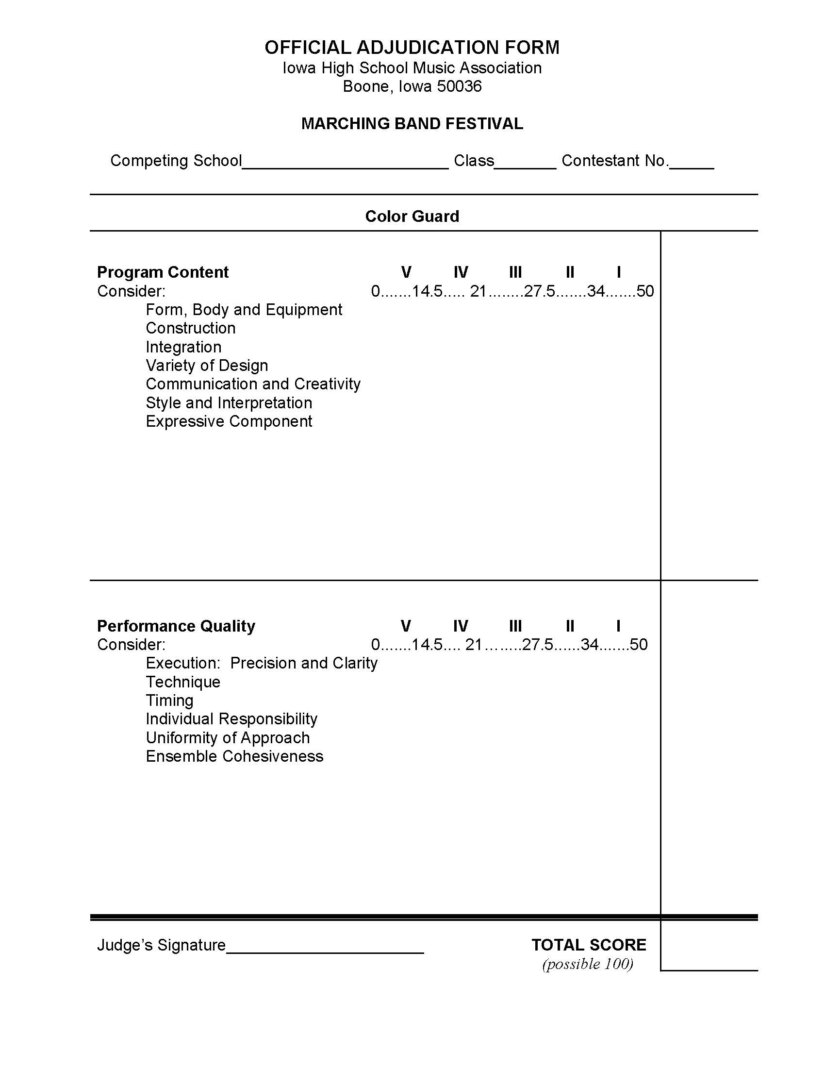
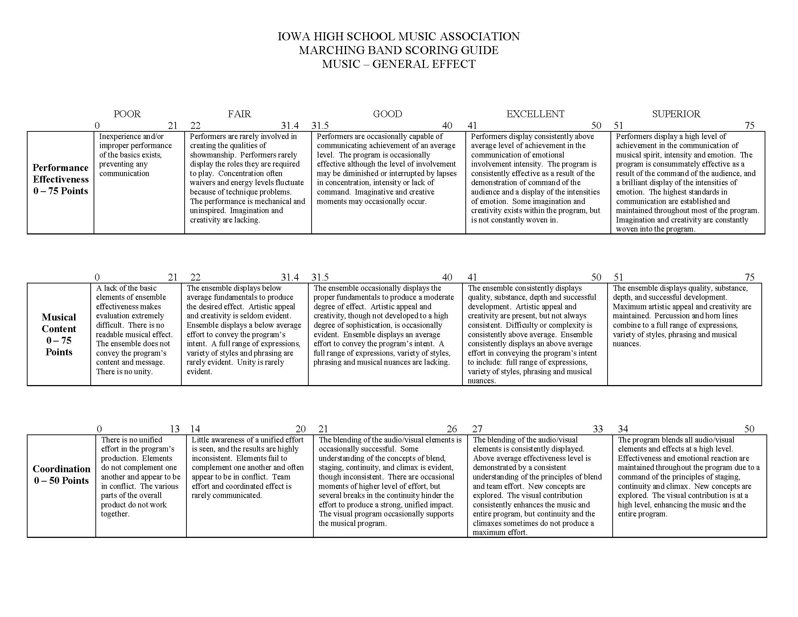
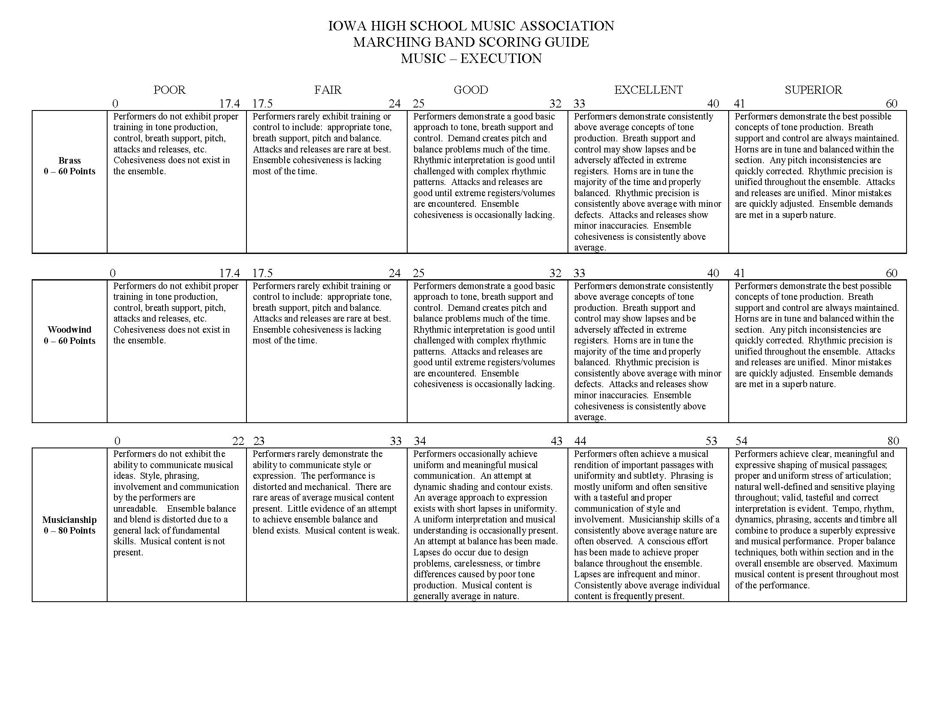
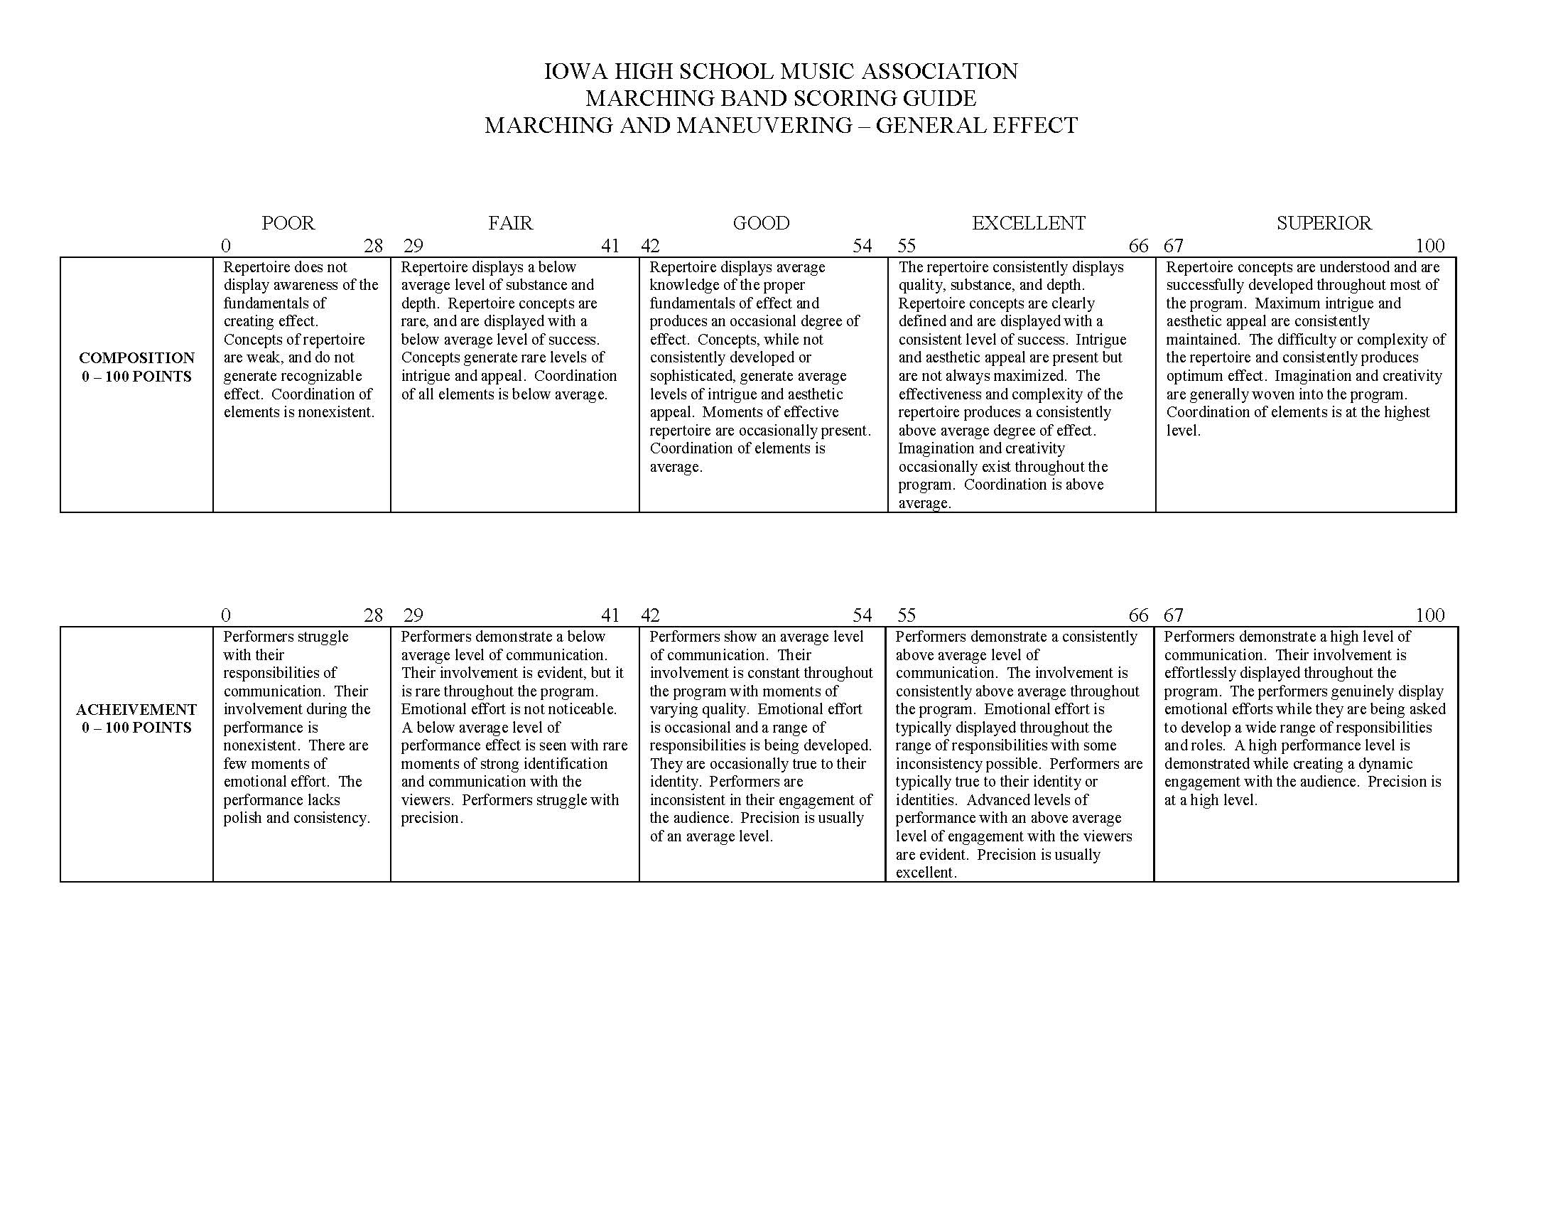
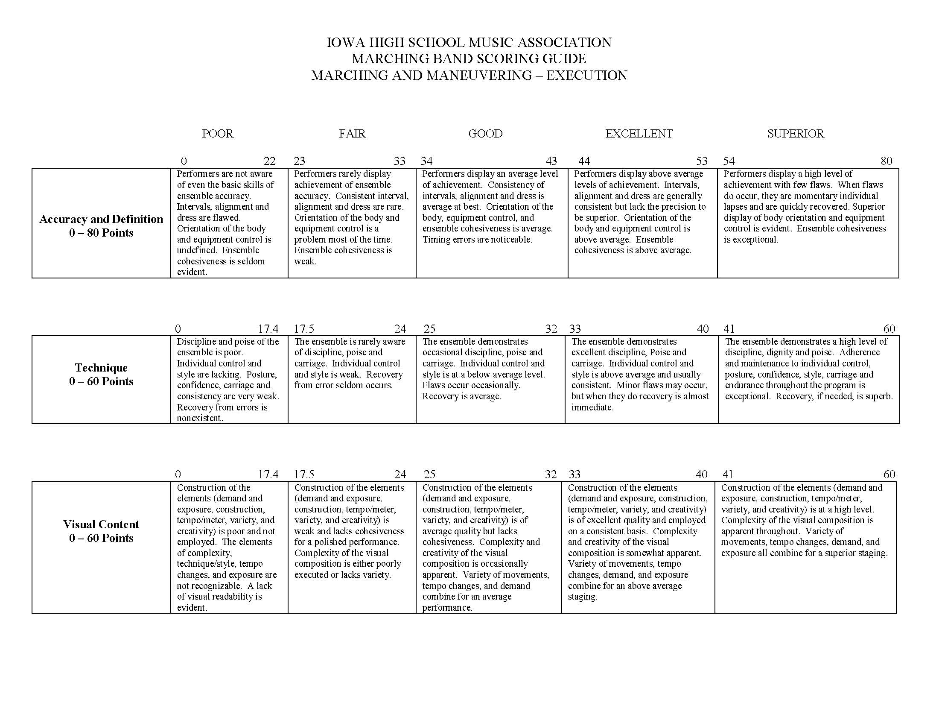
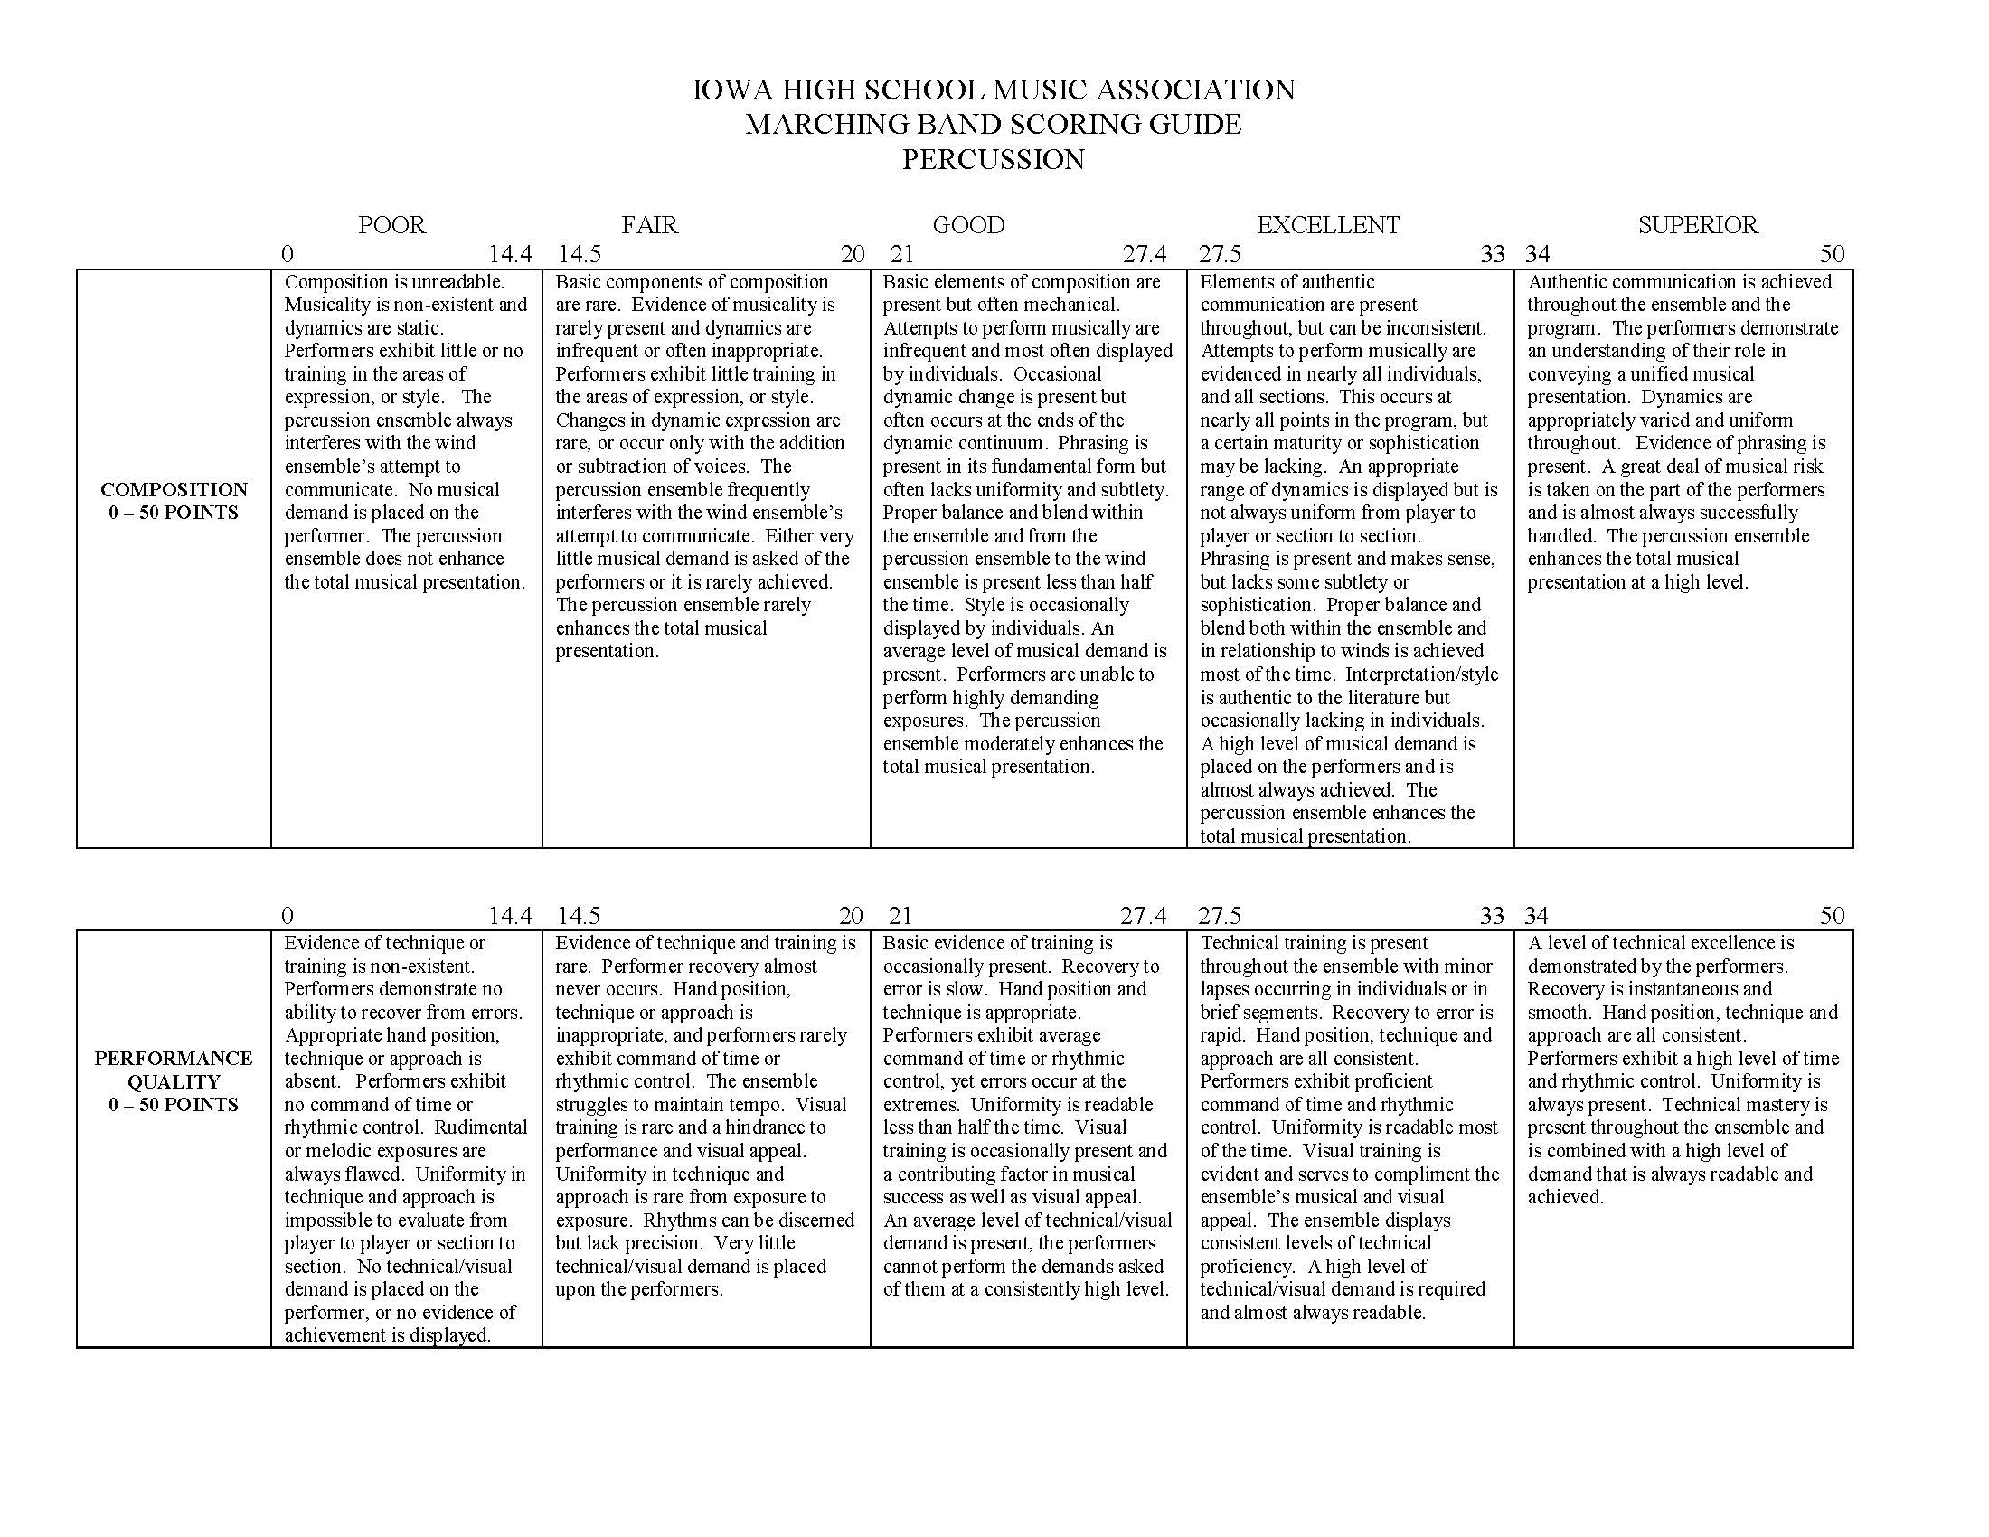
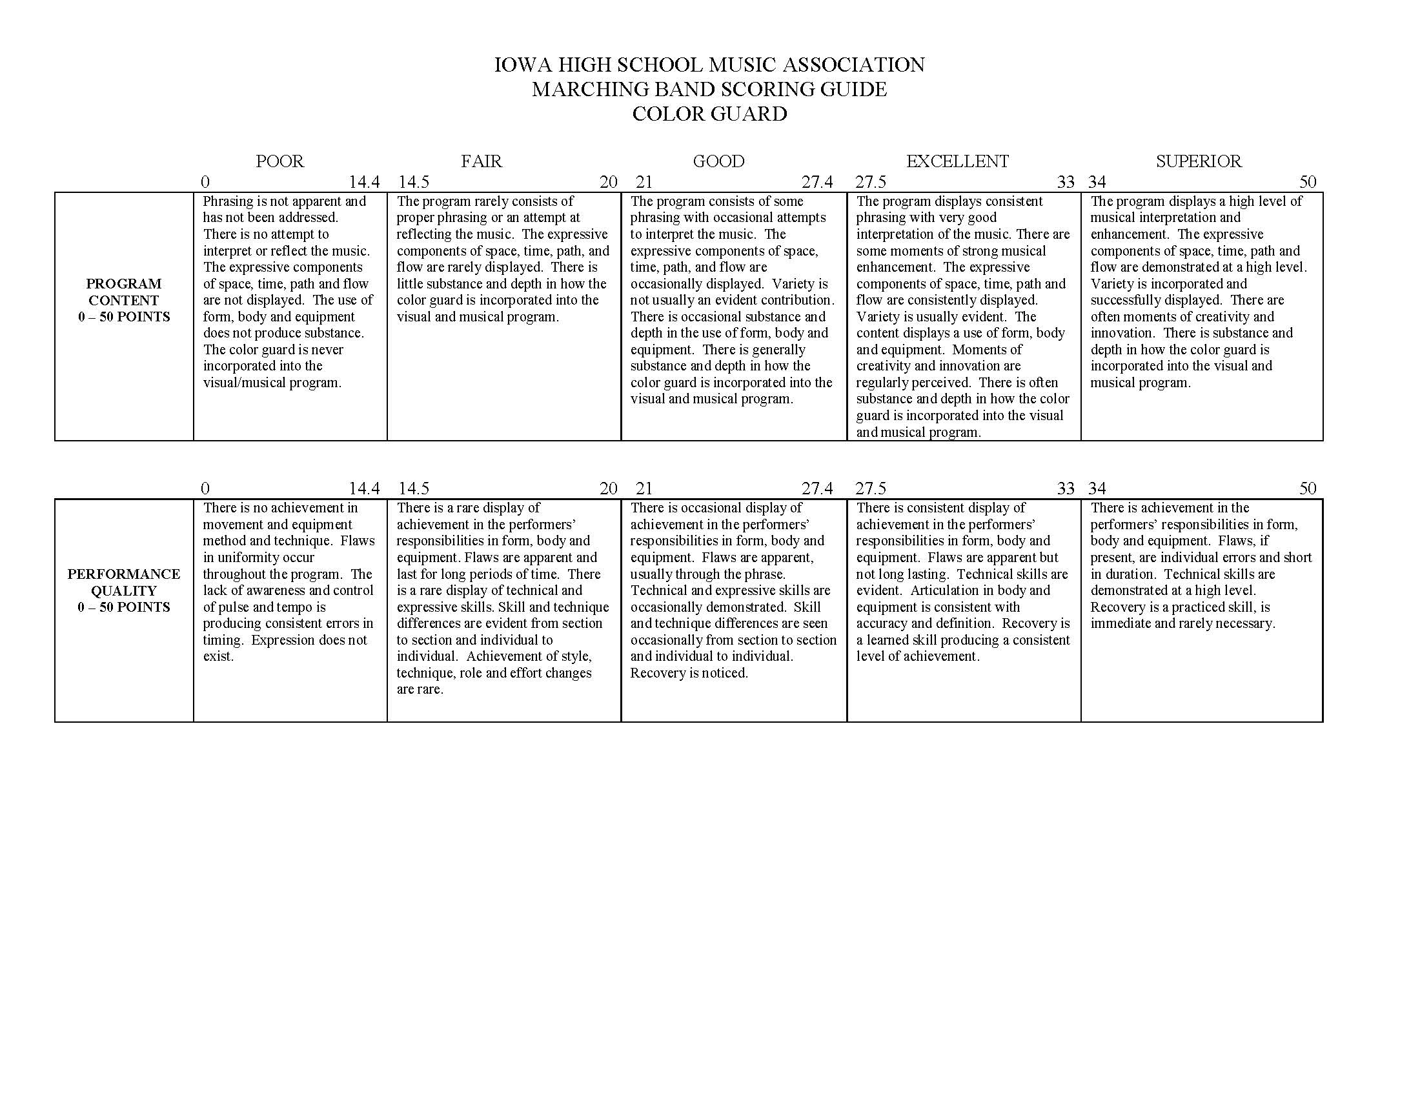
Adjudication Forms – Captions

Slide 11
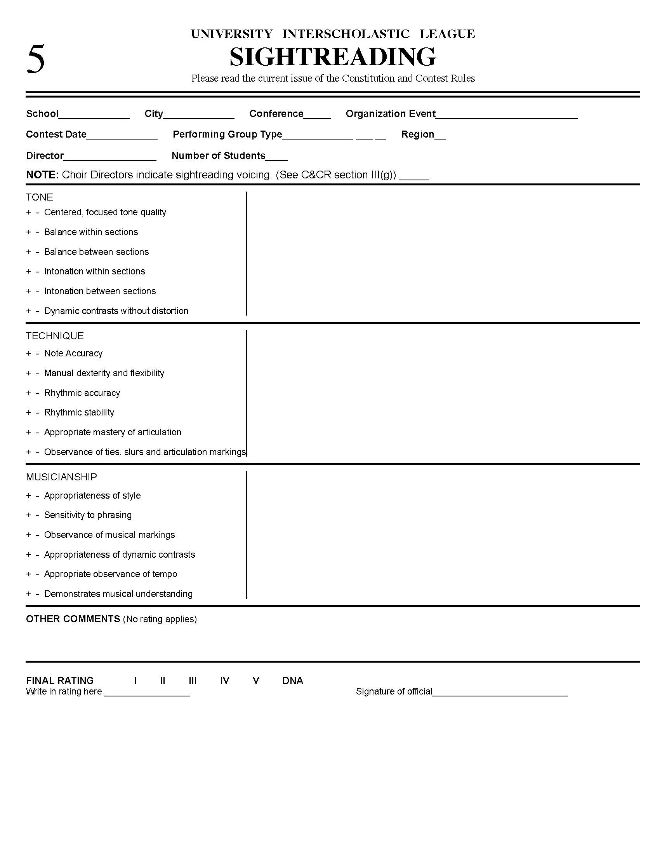
Adjudication Forms – Sight-reading

